Slide 1
Transparency and Reproducibility in Economics: Context, and Lessons learned from 1,000 papers
Lars Vilhuber
Cornell University
World Bank, 2022-10-04
The opinions expressed in this talk are solely the authors, and do not represent the views of the U.S. Census Bureau, the American Economic Association, or any of the funding agencies.
© Lars Vilhuber .
Notes:
I am going to
Very briefly describe the background we are coming from
Make note of the various elements of progress (and the broader picture) of open science
Describe some of the ongoing challenges
Provide some guidance based on the lessons learned in the past year

Slide 2
Context

Slide 3
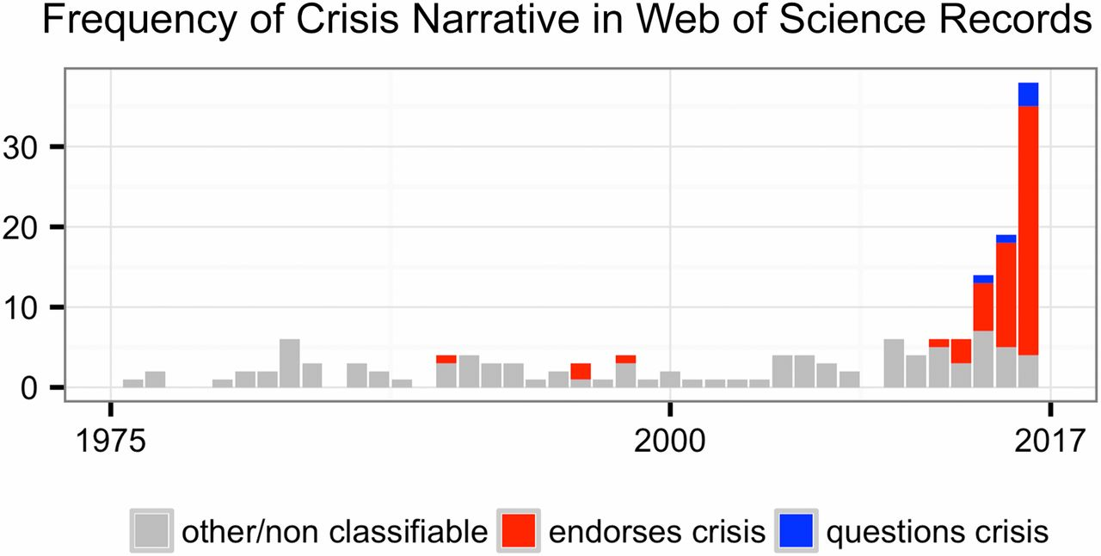
This reproducibility crisis thing….
https://doi.org/10.1073/pnas.1708272114
Notes:
Number of Web of Science records that in the title, abstract, or keywords contain one of the following phrases: “reproducibility crisis,” “scientific crisis,” “science in crisis,” “crisis in science,” “replication crisis,” “replicability crisis.” Records were classified by the author according to whether, based on title and abstracts, they implicitly or explicitly endorsed the crisis narrative described in the text (red), or alternatively questioned the existence of such a crisis (blue), or discussed “scientific crises” of other kinds or could not be classified due to insufficient information (gray).

Slide 4
The “crisis” in the 60s and 70s Sterling, 1959; Cohen, 1962; Lykken, 1968; Tukey, 1969; Greenwald, 1975; Meehl, 1978; Rosenthal, 1979
Low power
Flexibility in analysis
Selective reporting
Ignoring nulls
Lack of replication
Misuse of statistics
Source: Nosek Sackler talk 2017
Notes:
Source: Nosek, NAS.Sackler.2017.03.10
Examples from:
Button et al – Neuroscience
Ioannidis – why most results are false (Medicine)
GWAS
Biology
Two possibilities are that the percentage of positive results is inflated because negative results are much less likely to be published, and that we are pursuing our analysis freedoms to produce positive results that are not really there. These would lead to an inflation of false-positive results in the published literature.
Some evidence from bio-medical research suggests that this is occurring. Two different industrial laboratories attempted to replicate 40 or 50 basic science studies that showed positive evidence for markers for new cancer treatments or other issues in medicine. They did not select at random. Instead, they picked studies considered landmark findings. The success rates for replication were about 25% in one study and about 10% in the other. Further, some of the findings they could not replicate had spurred large literatures of hundreds of articles following up on the finding and its implications, but never having tested whether the evidence for the original finding was solid. This is a massive waste of resources.
Across the sciences, evidence like this has spurred lots of discussion and proposed actions to improve research efficiency and avoid the massive waste of resources linked to erroneous results getting in and staying in the literature, and about the culture of scientific practices that is rewarding publishing, perhaps at the expense of knowledge building. There have been a variety of suggestions for what to do. For example, the Nature article on the right suggests that publishing standards should be increased for basic science research.
[It is not in my interest to replicate – myself or others – to evaluate validity and improve precision in effect estimates (redundant). Replication is worth next to zero (Makel data on published replications; motivated to not call it replication; novelty is supreme – zero “error checking”; not in my interest to check my work, and not in your interest to check my work (let’s just each do our own thing and get rewarded for that)
Irreproducible results will get in and stay in the literature (examples from bio-med). Prinz and Begley articles (make sure to summarize accurately)
The Nature article by folks in bio-medicine is great. The solution they offer is a popular one in commentators from the other sciences -- raise publishing standards.

Slide 5
But some things HAVE changed! A bit of history…

Slide 6




Progress
Replication archives and Data (Code) Availability policies
1985!

Slide 7
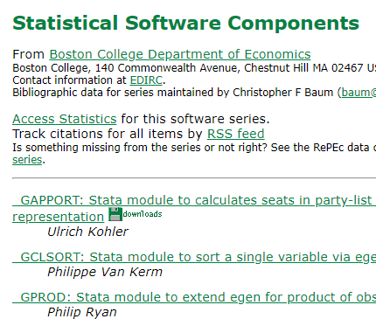

Progress
Replication archives and Data (Code) Availability policies
Shared open source software

Slide 8






Progress
Replication archives and Data (Code) Availability policies
Shared open source software
Better public-use and shared data

Slide 9


Progress
Replication archives and Data (Code) Availability policies
Shared open source software
Better public-use and shared data
Better ways of accessing preprints/ grey literature
Working paper in Econ,
e.g. NBER (WP1)
1973!
1994!
1991!

Slide 10



Progress
Replication archives and Data (Code) Availability policies
Shared open source software
Better public-use and shared data
Better ways of accessing preprints/ grey literature
Pre-registration of trials, experiments, and analyses

Slide 11
Second round (2012-)
Greater enforcement of data (and code) availability
2015, AJ Political Science
2016, Data Editor for ASA Software Section
2016, Statistical review added Science
2017: AEA appoints Data Editor, with mandate to do similar activities (also EJ, Restud)

Slide 12
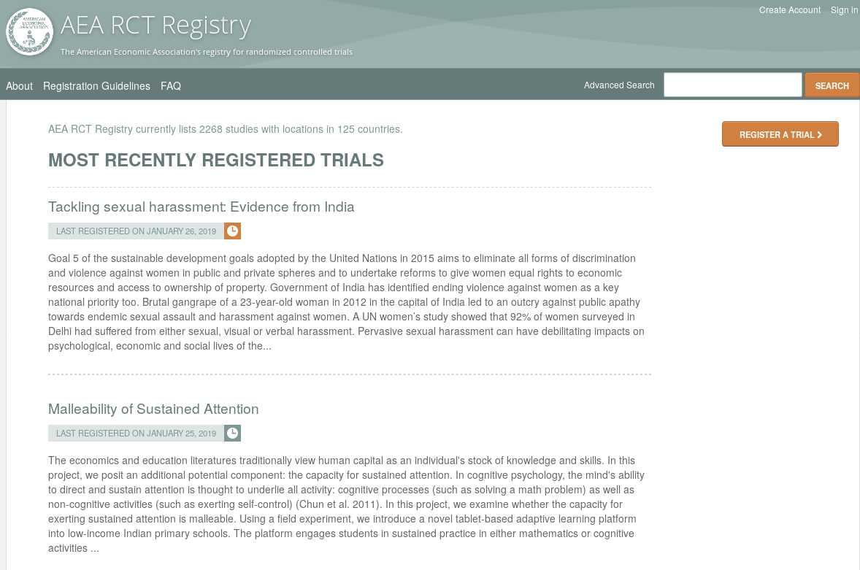
Pre-registration
“That information is especially helpful in research that emphasizes null hypothesis significance testing.
A thorough preregistration promotes transparency and openness and protects researchers from suspicions of p-hacking.”
https://www.psychologicalscience.org/publications/psychological_science/preregistration

Slide 13

Registered Reports
https://cos.io/rr
Chambers (2014)
Nosek & Lakens (2014)
Close cousin: Results-blind review

Slide 14


Preprints in other sciences
bioRxiv (2013)
PsyArXiv (2016)

Slide 15
Paluck (2018) https://osf.io/kvbnh/

Slide 16
So we’re good, right?

Slide 17
Hm….

Slide 18
A bit of background

Slide 19

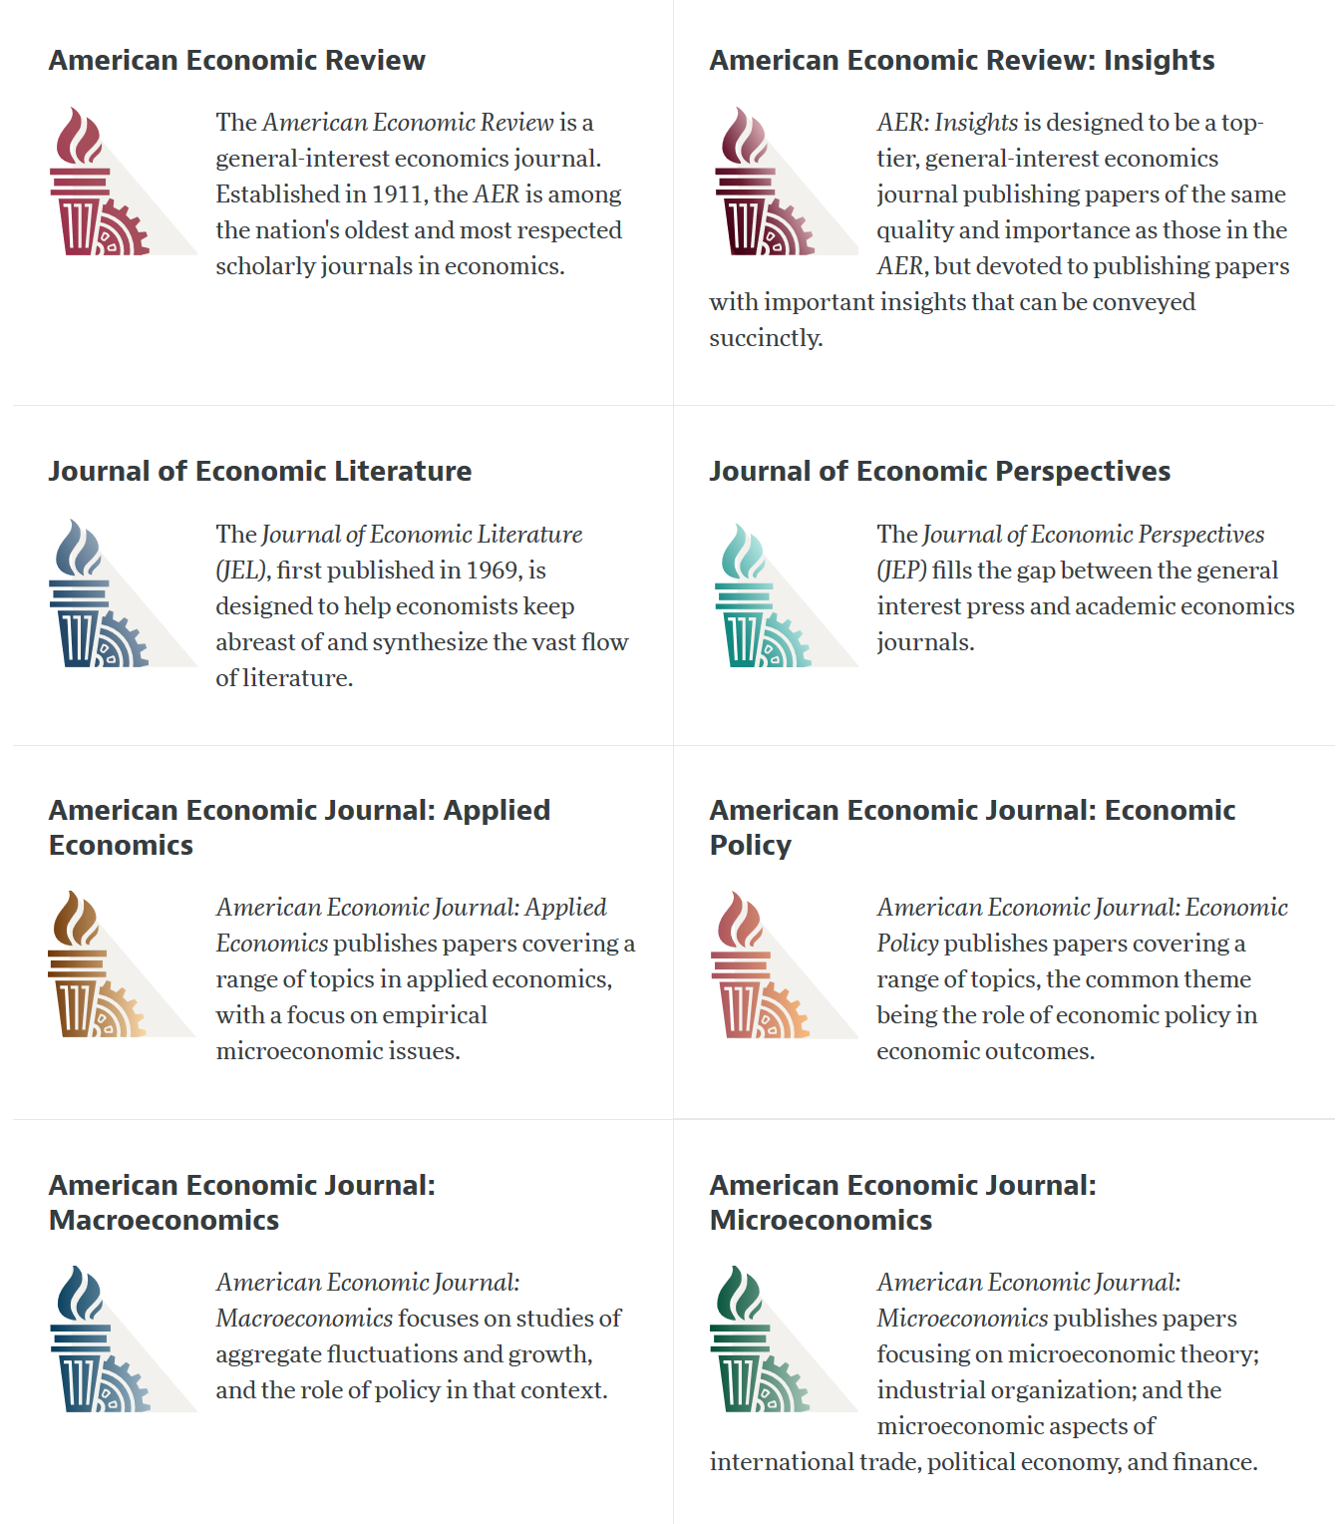

Slide 20
AEA Data & Code Availability Policy (2019)
It is the policy of the American Economic Association to publish papers only if the data used in the analysis are clearly and precisely documented and access to the data and code is clearly and precisely documented and is non-exclusive to the authors.
Authors of accepted papers that contain empirical work, simulations, or experimental work must provide, prior to acceptance, the data, programs, and other details of the computations sufficient to permit replication, as well as information about access to data and programs.

Slide 21
Current efforts at the AEA
Pre-emptively improve code archives
By conducting reproducibility checks when we can
By working with groups that conduct reproducibility checks when we cannot
Better archives
Greater transparency of the code and data archives
Better provenance tracking
Leave code where it is when appropriate
Leave data where it is almost always
Display that information
Notes:
Add logo from AEA

Slide 22
AEA Pre-Publication Verification
Every paper that receives a “conditional acceptance” is verified
Data citations
Quality of README
Quality of code
Reproducibility of code
Quality of metadata in the repository

Slide 23
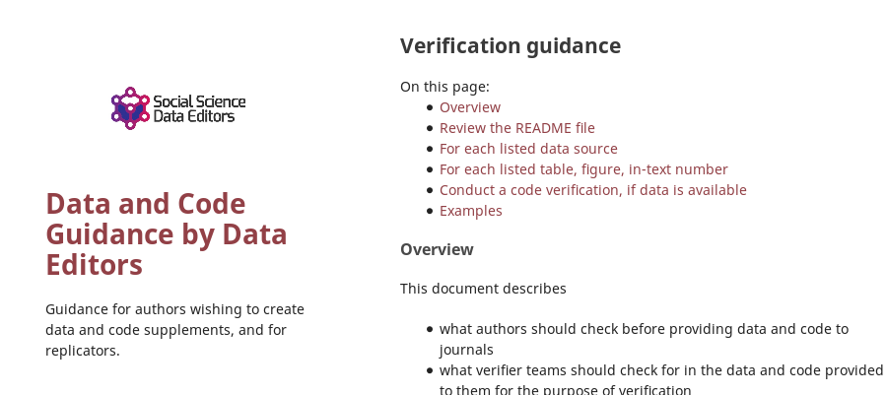

Action: Reproducibility Check

Slide 24
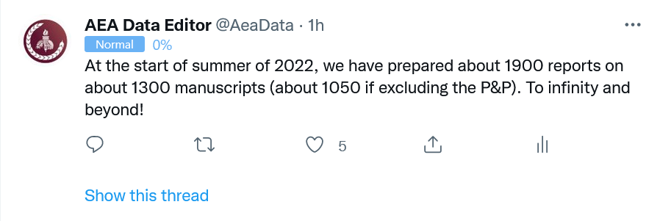
Stats on reproduced articles
Between July 16, 2019, and June 20, 2022, the AEA Data Editor team conducted
1900 assessments
for 1050 manuscripts (full papers)

Slide 25
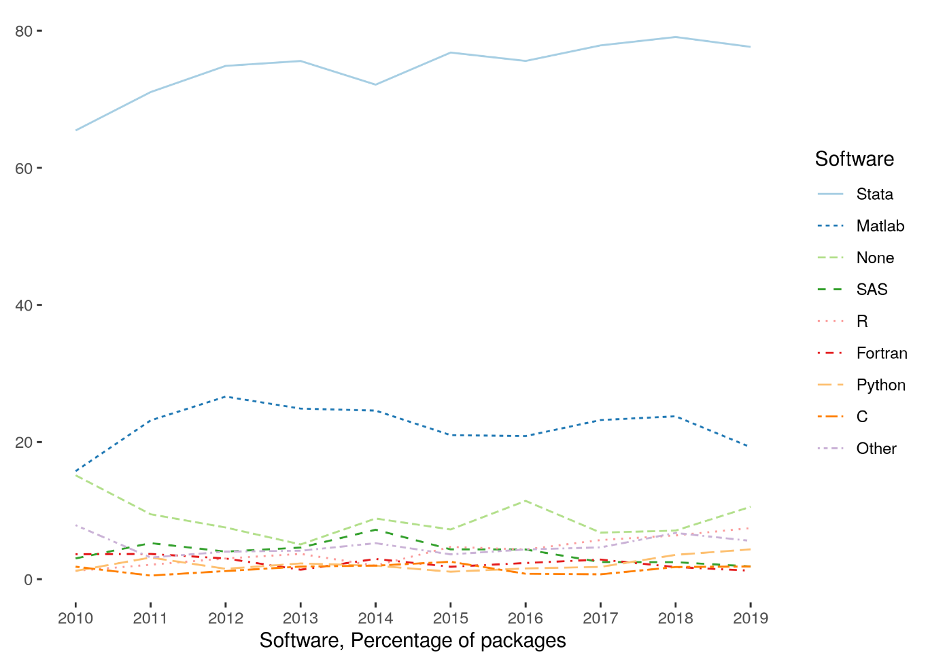
Very little diversity in software
Stata is the most popular statistical software in the journals of the AEA (72.96% of all supplements, 2010-2019)
followed by Matlab (22.45%)

Slide 26

Replication continuum
https://doi.org/10.17226/25303
08
Reproducibility
Narrow Replication (Pesaran 2003)
Pure Replication (Hamermesh 2007)
Verification (Clemens 2015)

Slide 27
Replication continuum
Same data | Same code | Same methods | Same context
08
Reproducibility
Narrow Replication (Pesaran 2003)
Pure Replication (Hamermesh 2007)
Verification (Clemens 2015)

Slide 28
What does reproducibility buy you?
Results in the paper were actually produced by the code (as claimed)
Replication package has a complete and exhaustive description of what is needed to produce those results

Slide 29

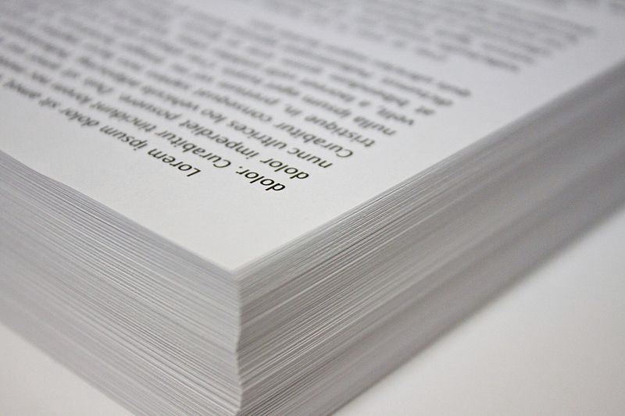
Ingredients of “research”
“Procedures” = computer code
“Materials (1)” = data
“Materials (2)” = computers

Slide 30
What does reproducibility NOT buy you?
Results in the paper are “right”
Replication package will work in two months time

Slide 31
Replication continuum
08
08
Reproducibility
Replicability
Narrow Replication (Pesaran 2003)
Pure Replication (Hamermesh 2007)
Verification (Clemens 2015)
Wide Replication (Pesaran 2003)
Statistical Replication (Hamermesh 2007)
Reproduction/Reanalysis (Clemens 2015)

Slide 32
Replication continuum
Same data | Different code | Same methods | Same context
 | or software
08
08
Reproducibility
Replicability
Narrow Replication (Pesaran 2003)
Pure Replication (Hamermesh 2007)
Verification (Clemens 2015)
Wide Replication (Pesaran 2003)
Statistical Replication (Hamermesh 2007)
Reproduction/Reanalysis (Clemens 2015)

Slide 33
Replication continuum
New data | Same code | Same methods | Same context
collection
08
08
Reproducibility
Replicability
Narrow Replication (Pesaran 2003)
Pure Replication (Hamermesh 2007)
Verification (Clemens 2015)
Wide Replication (Pesaran 2003)
Statistical Replication (Hamermesh 2007)
Reproduction/Reanalysis (Clemens 2015)

Slide 34
Replication continuum
08
08
08
Reproducibility
Replicability
Generalizability
Narrow Replication (Pesaran 2003)
Pure Replication (Hamermesh 2007)
Verification (Clemens 2015)
Wide Replication (Pesaran 2003)
Statistical Replication (Hamermesh 2007)
Reproduction/Reanalysis (Clemens 2015)
Wider Replication (Pesaran 2003)
Scientific Replication (Hamermesh 2007)
Reanalysis/Robustness (Clemens 2015)

Slide 35
Replication continuum
Different data | Different code | Different | Different
 | or software | methods | context or
 |  |  | country
08
08
08
Reproducibility
Replicability
Generalizability
Narrow Replication (Pesaran 2003)
Pure Replication (Hamermesh 2007)
Verification (Clemens 2015)
Wide Replication (Pesaran 2003)
Statistical Replication (Hamermesh 2007)
Reproduction/Reanalysis (Clemens 2015)
Wider Replication (Pesaran 2003)
Scientific Replication (Hamermesh 2007)
Reanalysis/Robustness (Clemens 2015)

Slide 36
What does reproducibility ALSO buy you?
It may be worth your while to start thinking about replicating or generalizing the results! (Plausibility)

Slide 37
Lessons?

Slide 38
Observation 0
Researchers don’t…
Re-run their code before submitting
Don’t streamline (automate) enough
Are not careful about how they document data sources
Fail to curate their own data

Slide 39
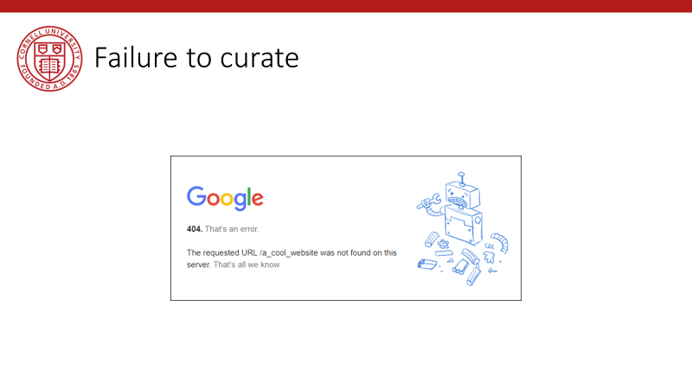
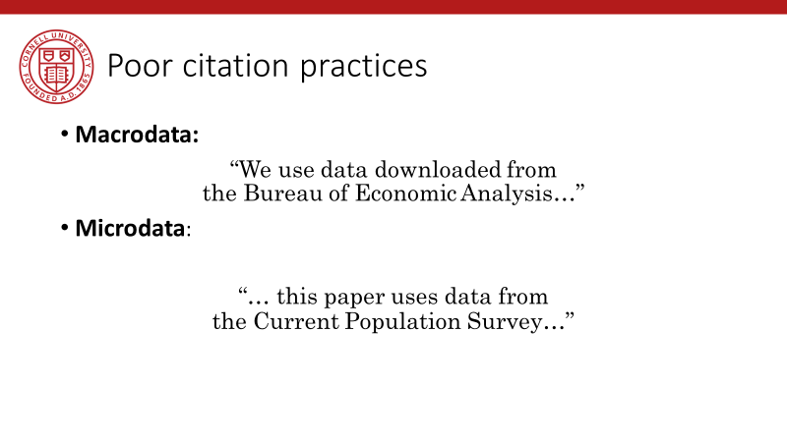
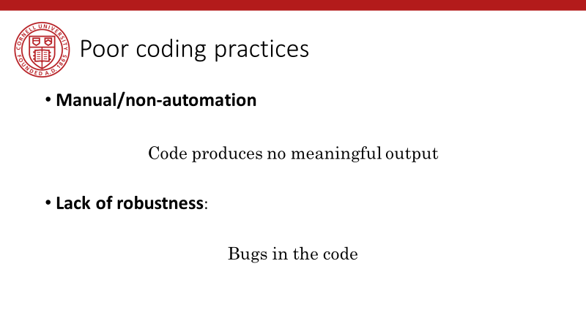
Back in 2019…

Slide 40
Lessons!

Slide 41
Computational empathy

Slide 42
Lesson 1: Computational empathy
In the words of the slogan popularized by Buckheit and Donoho (1995),
“a scientific publication is [...] merely advertising of the scholarship: [...] the complete software development environment and the complete set of instructions which generated the figures.”

Slide 43
Lesson 1: Computational empathy
Put yourself in the position of the reader of the research compendium:
Can they understand those instructions?
Under what premises/ shared common knowledge?
What might they assume about the computing environment?
How concise or diffuse are the instructions?

Slide 44
Lesson 1: Computational empathy
Potential readers
You (in 4 years, between prepping 2 new courses, an R&R, a new child, and tenure coming up in 2 years)
Your RA (in 4 years, because you are… see above)
Your future readers who will cite you (in 4-10 years, who may want to extend or replicate your study, but won’t if it is too complex)

Slide 45
Lesson 1: Computational empathy
= “Pity the poor replicator”

Slide 46
Intermezzo

Slide 47
Observation 1
Social scientists do not read the manual
(beyond the first few pages)

Slide 48
Observation 1: Please read the manual
Persistent misconceptions
About setting working directories
How to record pathnames
How to leverage loops
How to leverage subroutines
How to pass parameters
How (and if) to use controller scripts

Slide 49
Observation 2
Social scientists love point-and-click interfaces (which are hard to reproduce)

Slide 50
Observation 2: point-and-click interfaces
This is reflected in
GIS (maps) that appear in papers
Data extraction tools
How to run software (any software)

Slide 51
Observation 1 and 2 are the result of a lack of Computational Empathy, and lead to high burden of reproducibility and replicability

Slide 52
Solutions?

Slide 53
Hold that thought, we will get there.

Slide 54
Data acumen

Slide 55
Data acumen
“the ability to understand data, to make good judgments about and good decisions with data, and to use data analysis tools responsibly and effectively”
National Academies of Sciences, Engineering, and Medicine. 2018. Data Science for Undergraduates: Opportunities and Options. Washington, DC: The National Academies Press. https://doi.org/10.17226/25104.

Slide 56
Lesson 2: Data acumen in the context of reproducibility
Two key components
Data provenance
Where did the data come from which I used?
Data preservation
Where do I put the data I generated?
What if the data I used are not “robustly preserved”?
What do you mean by that?

Slide 57
Data provenance

Slide 58
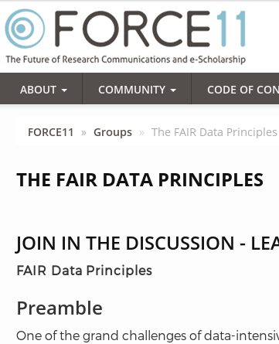
Action: Data citations and metadata
What is FAIR?
Findable,
Accessible,
Interoperable, and
Re-usable

Slide 59
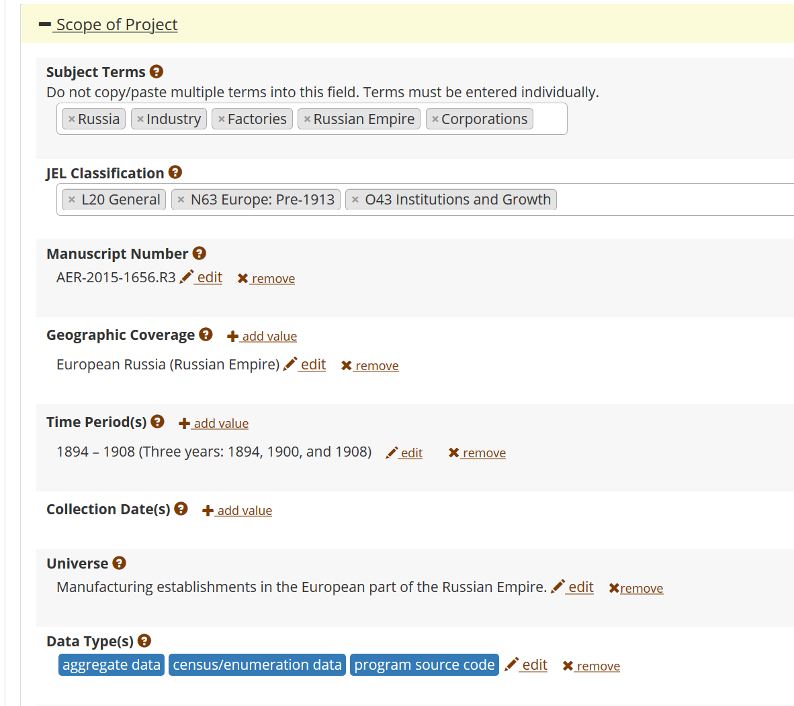
FAIR data principles rely on metadata
Notes:
Show metadata for this page

Slide 60
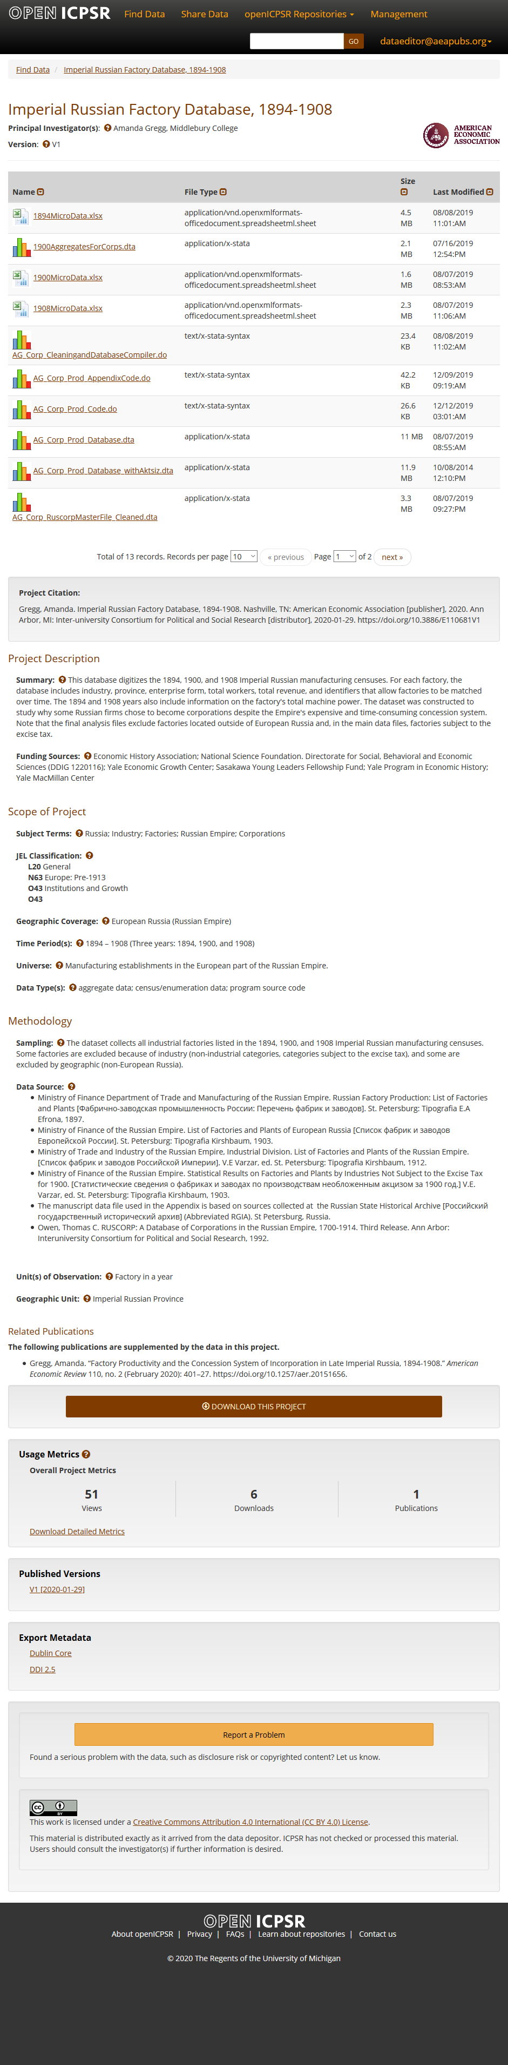

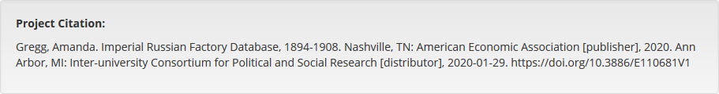
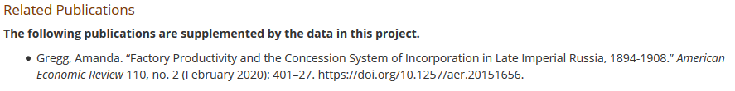

Slide 61
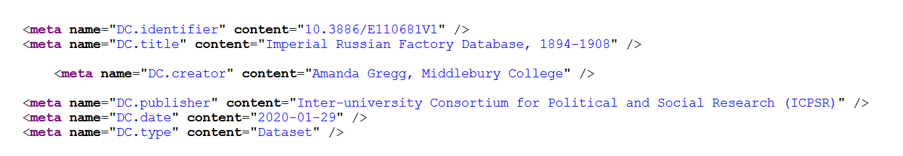

Slide 62
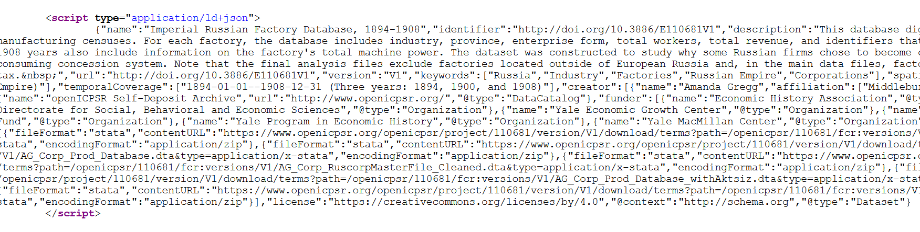

Slide 63
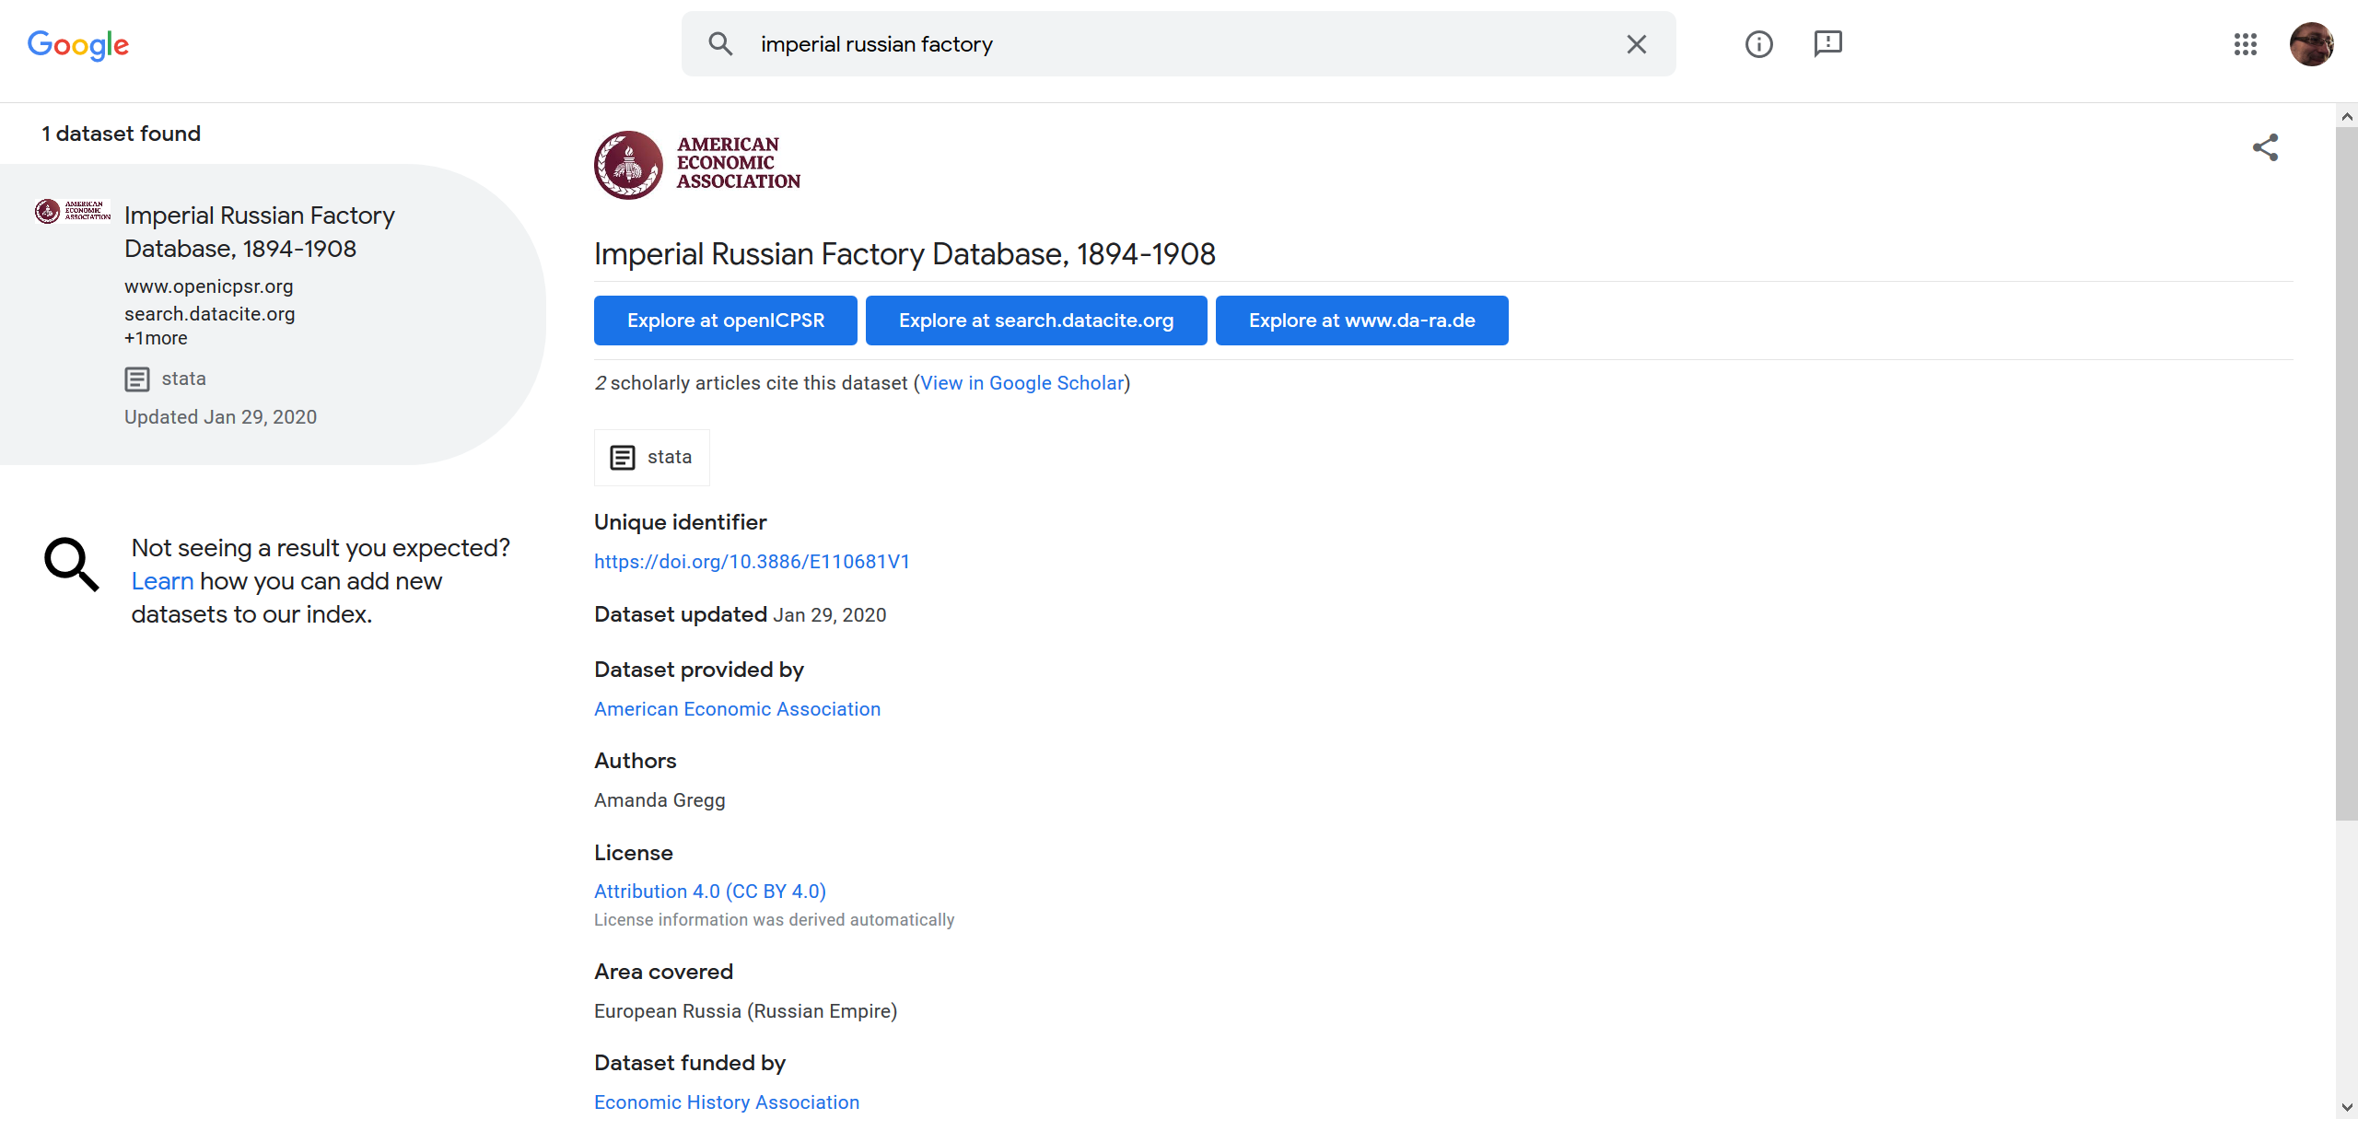
… and findability relies on metadata

Slide 64
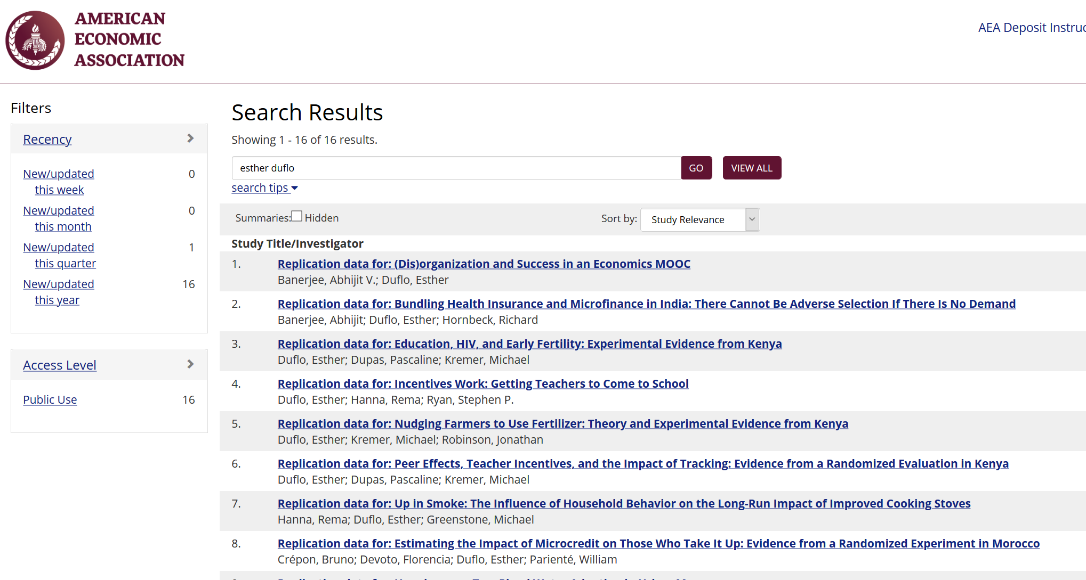

Slide 65
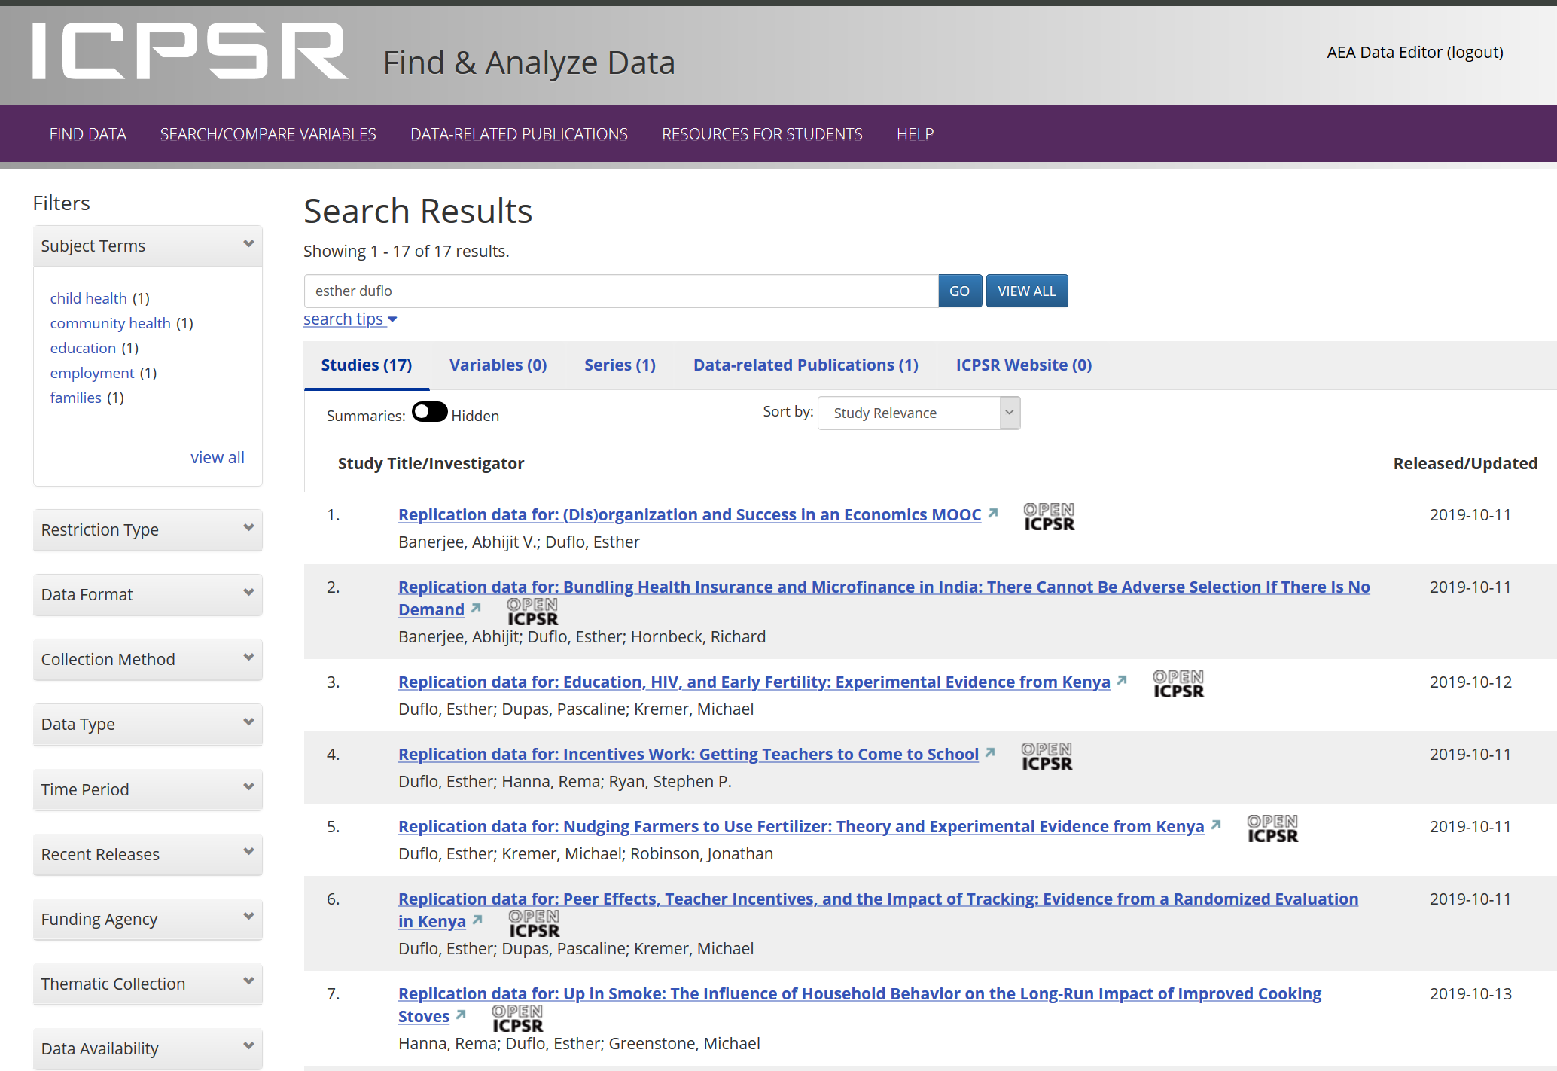

Slide 66
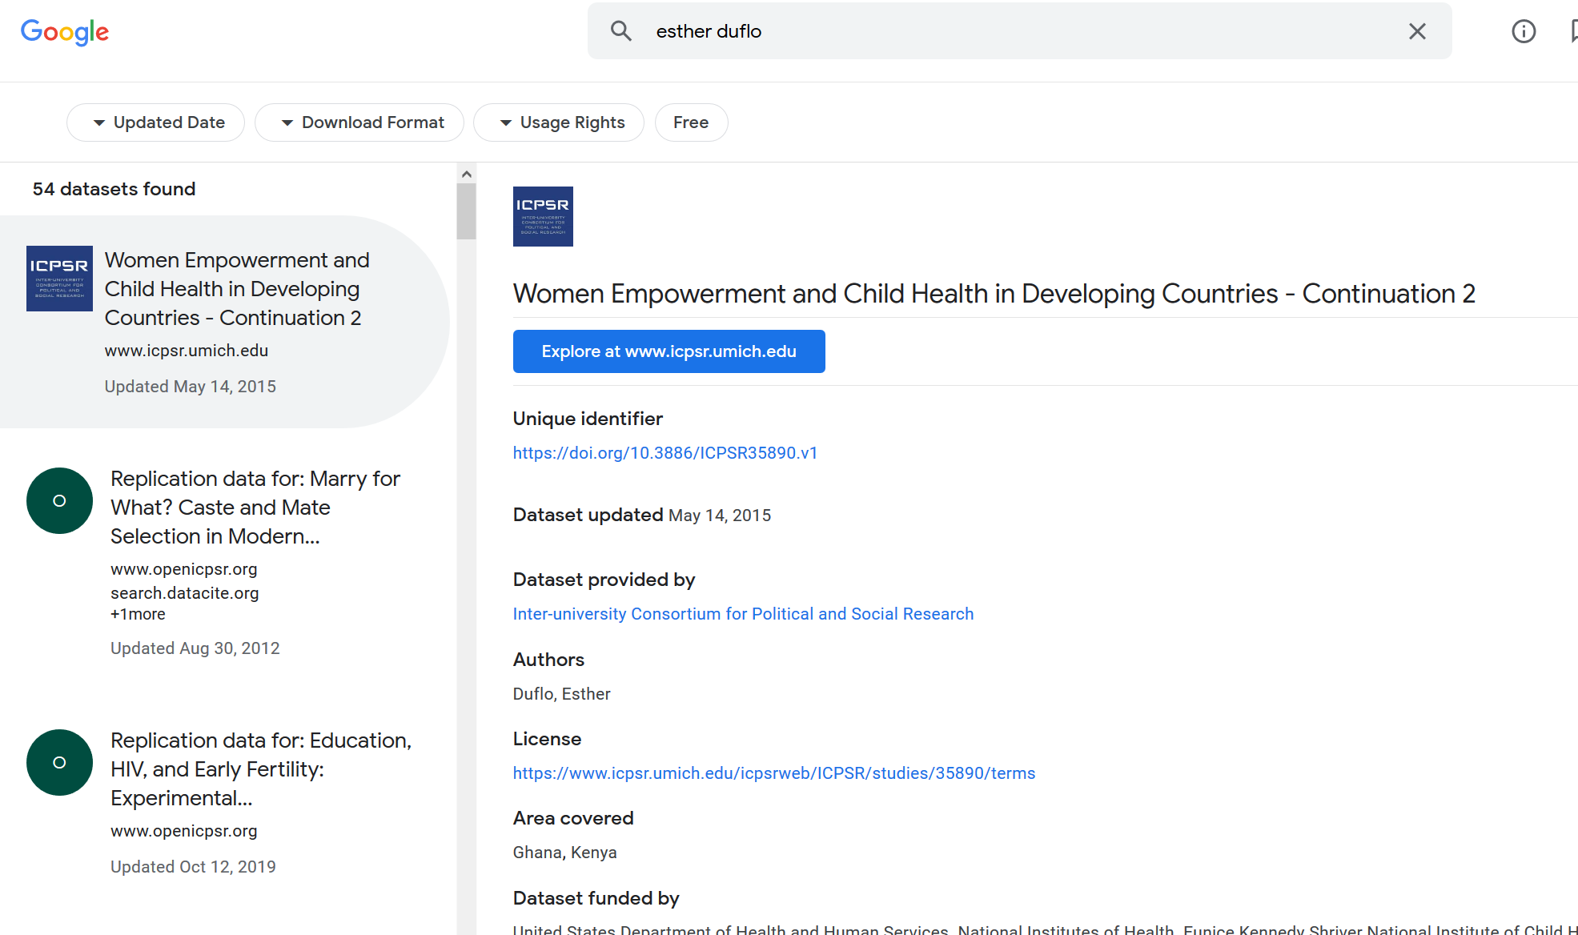

Slide 67
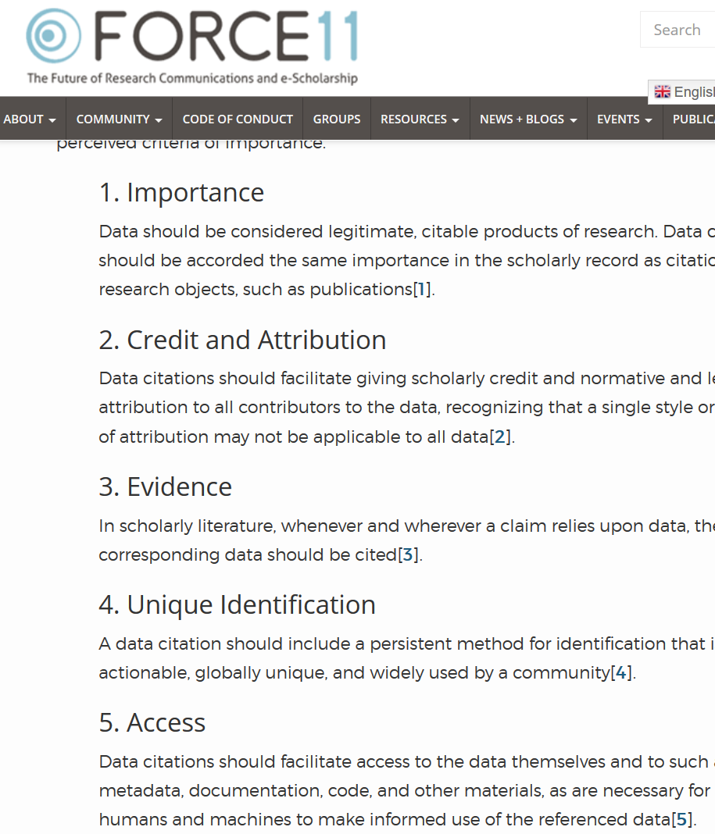

Starts with Data Citations
Data Citation Principles
Image of a standard data citation
Data Citation Synthesis Group: Joint Declaration of Data Citation Principles. Martone M. (ed.) San Diego CA: FORCE11; 2014 [https://www.force11.org/group/joint-declaration-data-citation-principles-final].

Slide 68
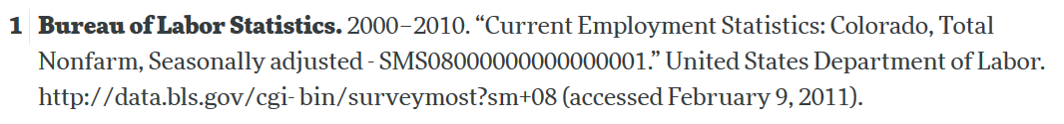
Starts with Data Citations
Data Citation Principles
Image of a standard data citation
Data Citation Synthesis Group: Joint Declaration of Data Citation Principles. Martone M. (ed.) San Diego CA: FORCE11; 2014 [https://www.force11.org/group/joint-declaration-data-citation-principles-final].

Slide 69
Observation 3
Social scientists are not trained to cite data

Slide 70
Citing restricted-access data
“Well, I can’t download the data, so I can’t cite it.”

Slide 71

Would you buy a car from this guy?

Slide 72
Provenance!
Does the sales person have a good record?
Where does the car come from?
What do we know about the car?

Slide 73
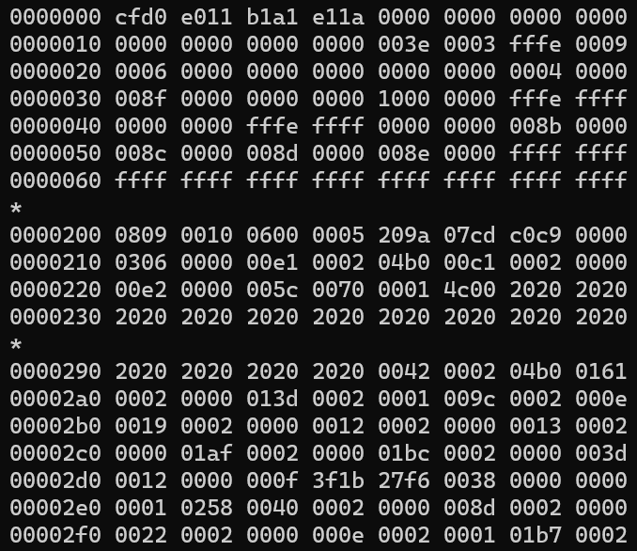
Would you use this data?

Slide 74
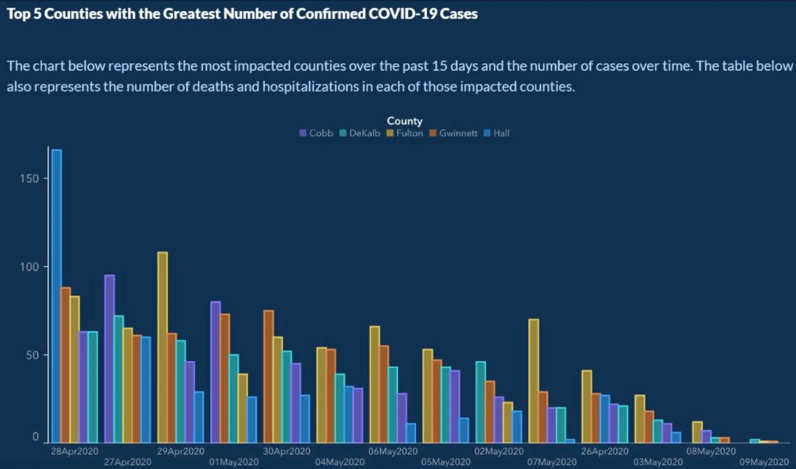
Or would you trust this data?

Slide 75
Provenance!
Does the provider have a good record?
Where do the data come from?
What do we know about the data?
Metadata!

Slide 76
Would you use this data?

Slide 77
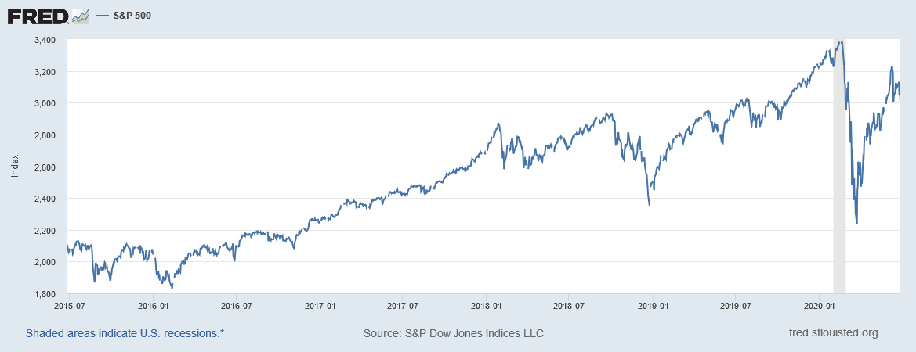
“It’s a file called stockmarket.xlsx”
2101.49
2057.64
2063.11
2077.42
2076.78
0
2068.76
2081.34
2046.68
2051.31
2076.62
2099.60
2108.95
2107.40
2124.29
2126.64
2128.28
2119.21
2114.15
2102.15
2079.65
2067.64
2093.25
2108.57
2108.63
2103.84

Slide 78
“It’s a file called SP500.xlsx”
SP500 | S&P 500, Index, Daily, Not Seasonally Adjusted
Frequency: Daily, Close
observation_date | SP500
2015-06-26 | 2101.49
2015-06-29 | 2057.64
2015-06-30 | 2063.11
2015-07-01 | 2077.42
2015-07-02 | 2076.78
2015-07-03 | 0
2015-07-06 | 2068.76
2015-07-07 | 2081.34
2015-07-08 | 2046.68
2015-07-09 | 2051.31
2015-07-10 | 2076.62
2015-07-13 | 2099.60
2015-07-14 | 2108.95
2015-07-15 | 2107.40
2015-07-16 | 2124.29
2015-07-17 | 2126.64
2015-07-20 | 2128.28

Slide 79
“It’s a file called SP500.xlsx, downloaded from FRED.”
SP500 | S&P 500, Index, Daily, Not Seasonally Adjusted
Frequency: Daily, Close
observation_date | SP500
2015-06-26 | 2101.49
2015-06-29 | 2057.64
2015-06-30 | 2063.11
2015-07-01 | 2077.42
2015-07-02 | 2076.78
2015-07-03 | 0
2015-07-06 | 2068.76
2015-07-07 | 2081.34
2015-07-08 | 2046.68
2015-07-09 | 2051.31
2015-07-10 | 2076.62
2015-07-13 | 2099.60
2015-07-14 | 2108.95
2015-07-15 | 2107.40
2015-07-16 | 2124.29
2015-07-17 | 2126.64
2015-07-20 | 2128.28

Slide 80
“It’s a file called SP500.xlsx, downloaded from FRED.”
S&P Dow Jones Indices LLC. 2020. “S&P 500 [SP500] [dataset]”, retrieved from FRED, Federal Reserve Bank of St. Louis; https://fred.stlouisfed.org/series/SP500, June 26, 2020.
SP500 | S&P 500, Index, Daily, Not Seasonally Adjusted
Frequency: Daily, Close
observation_date | SP500
2015-06-26 | 2101.49
2015-06-29 | 2057.64
2015-06-30 | 2063.11
2015-07-01 | 2077.42
2015-07-02 | 2076.78
2015-07-03 | 0
2015-07-06 | 2068.76
2015-07-07 | 2081.34
2015-07-08 | 2046.68
2015-07-09 | 2051.31
2015-07-10 | 2076.62
2015-07-13 | 2099.60
2015-07-14 | 2108.95
2015-07-15 | 2107.40
2015-07-16 | 2124.29
2015-07-17 | 2126.64
2015-07-20 | 2128.28

Slide 81
“SP500.xlsx, from S&P (2020). Not provided as part of replication package because © S&P. ”
S&P Dow Jones Indices LLC. 2020. “S&P 500 [SP500] [dataset]”, retrieved from FRED, Federal Reserve Bank of St. Louis; https://fred.stlouisfed.org/series/SP500, June 26, 2020.
SP500 | S&P 500, Index, Daily, Not Seasonally Adjusted
Frequency: Daily, Close
observation_date | SP500
2015-06-26 | 2101.49
2015-06-29 | 2057.64
2015-06-30 | 2063.11
2015-07-01 | 2077.42
2015-07-02 | 2076.78
2015-07-03 | 0
2015-07-06 | 2068.76
2015-07-07 | 2081.34
2015-07-08 | 2046.68
2015-07-09 | 2051.31
2015-07-10 | 2076.62
2015-07-13 | 2099.60
2015-07-14 | 2108.95
2015-07-15 | 2107.40
2015-07-16 | 2124.29
2015-07-17 | 2126.64
2015-07-20 | 2128.28

Slide 82
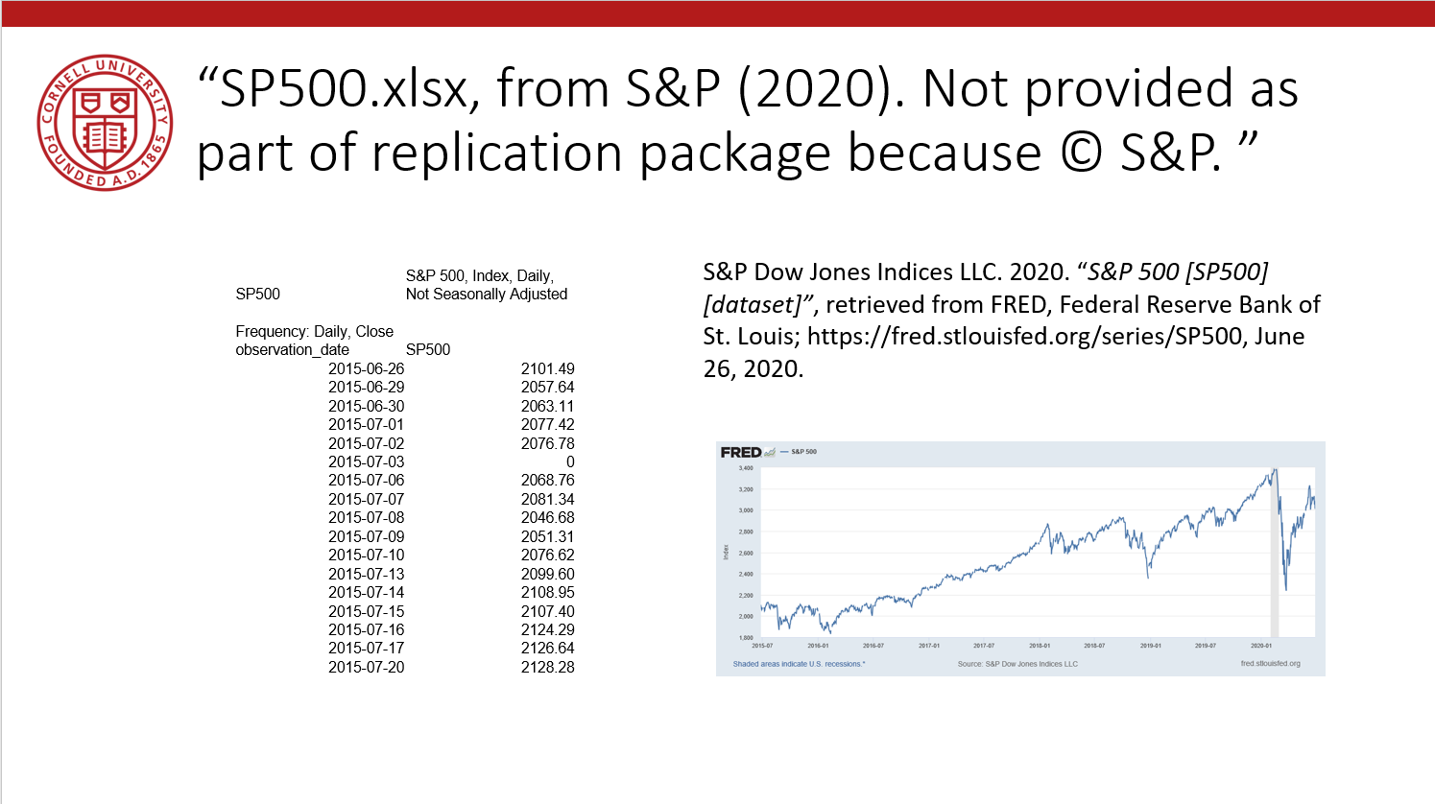
Data Availability Statements
Describes data file, where to get it, how to get it, and any conditions of obtaining it

Slide 83
Data Citation
Attributes the file to the proper source

Slide 84
Some practical tips
(based on 1000 articles)

Slide 85
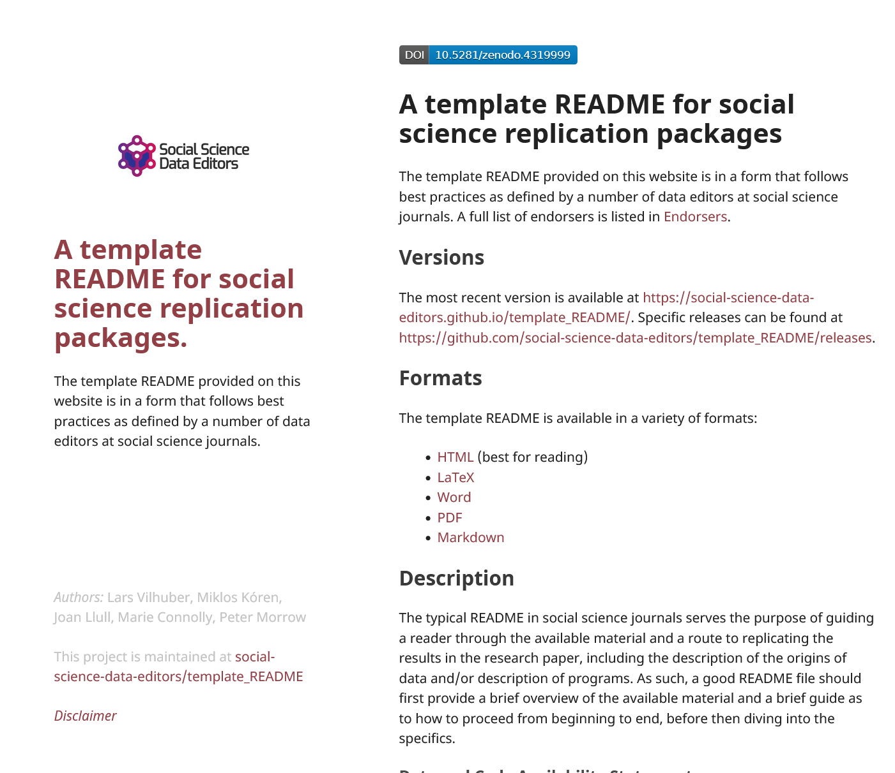
1. Computational empathy
Focal reader: your next RA in 4 years
Interaction: you hand them your README, but don’t have time to go through all the details…
Budget constraint: It shouldn’t take too many RA hours
Time constraint: It shouldn’t take more than 1 week to “get it”

Slide 86
Solution 1: Computational Empathy
Use the Social Science Data Editors’ template README https://doi.org/10.5281/zenodo.4319999

Slide 87
Keeping track: Students and Researchers
Computational empathy Consider the next person to run the analysis, and don’t assume too much

Slide 88
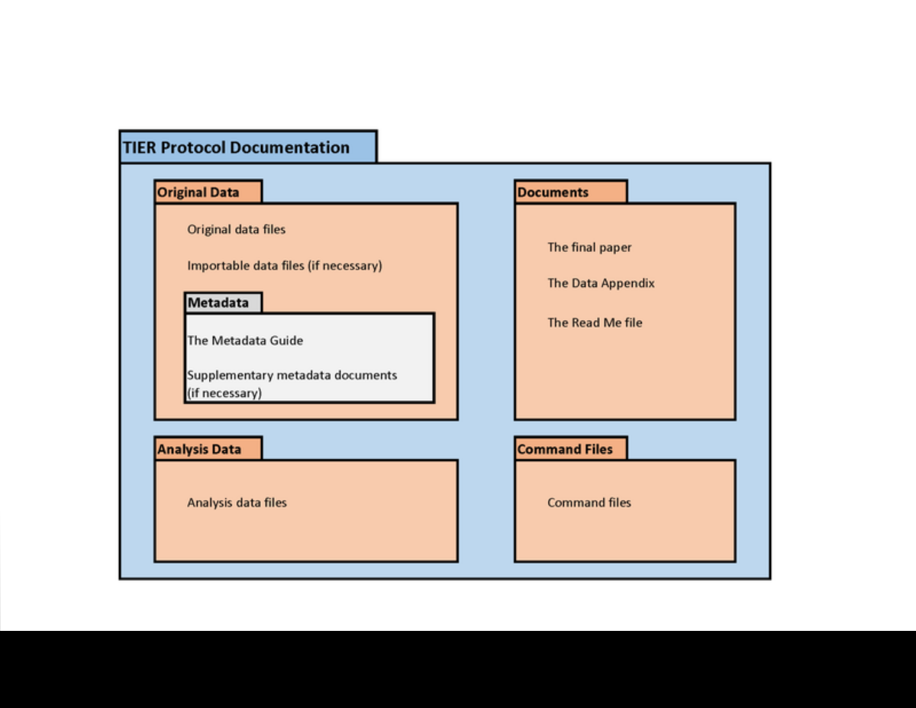
2. Keeping track of data: Data provenance
Keep all information as you collect data
See TIER Protocol for good and simple guidance
If you must use a point-and-click tool, keep detailed instructions
Also: obsolescence
Try to use API, bulk download, or packages that allow for extraction
Also: obsolescence of API

Slide 89
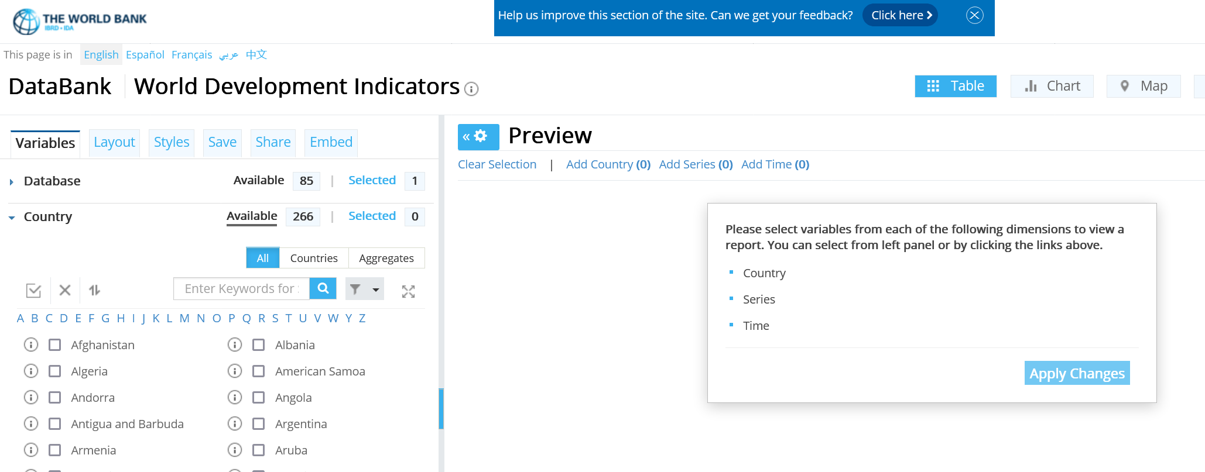
API? But the interface is so cool!
World Development Indicators

Slide 90
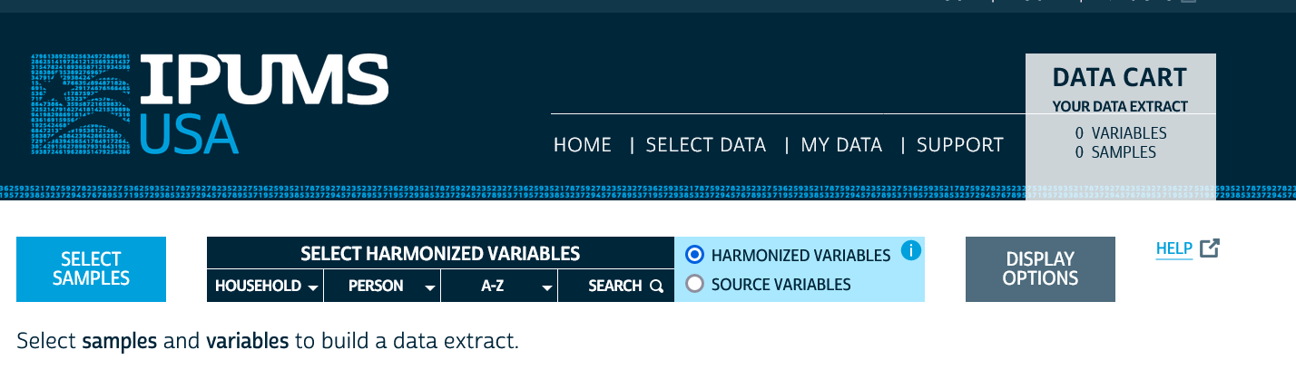
API? But the interface is so cool!
IPUMS

Slide 91
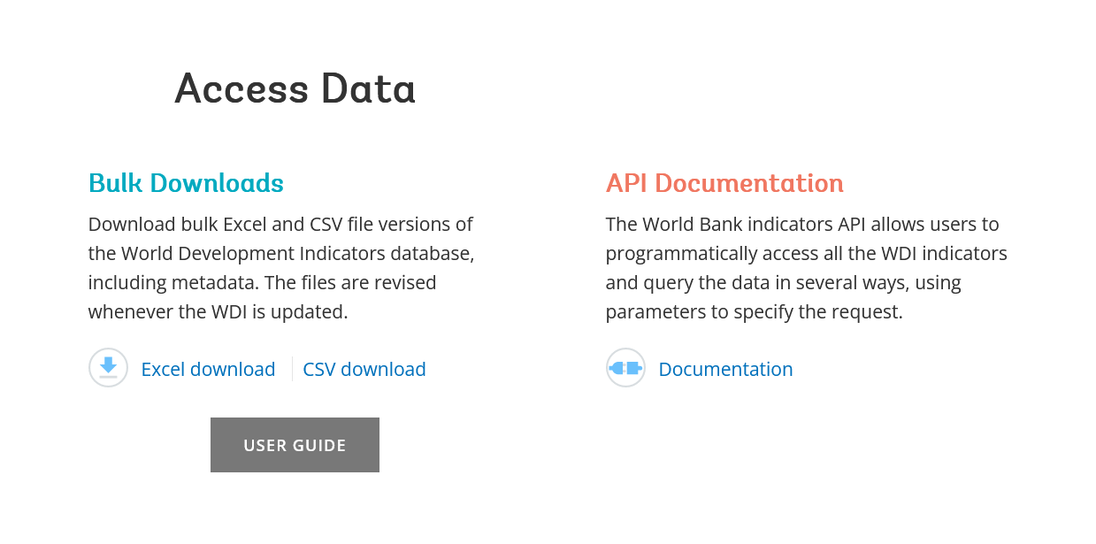
API or Bulk Download
World Development Indicators

Slide 92
API or Bulk Download
World Development Indicators
. ssc install wbopendata
. wbopendata, country(ago;bdi;chi;dnk;esp) indicator(sp.pop.0610.fe.un) /// > year(2000:2010) clear long

Slide 93
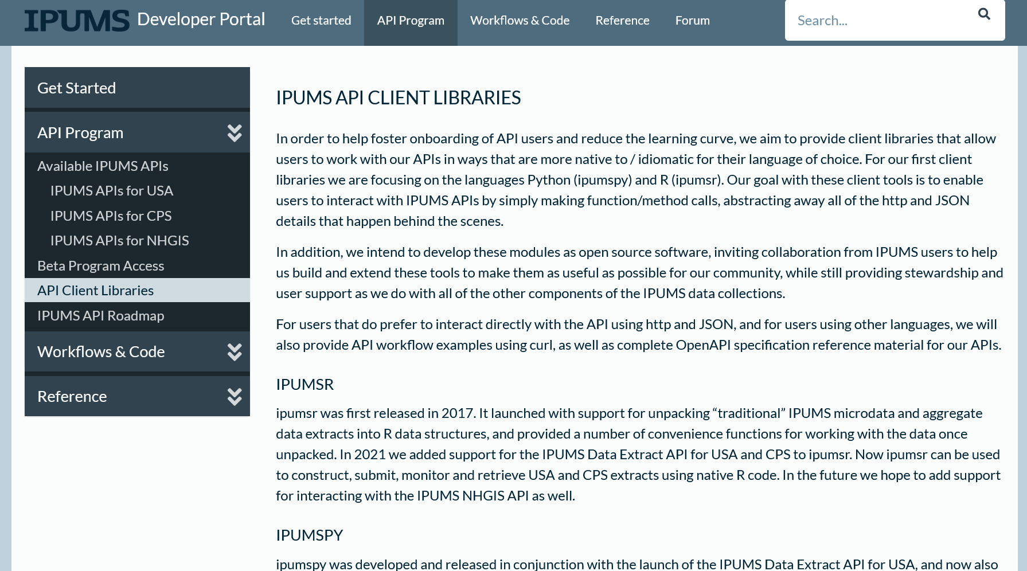
API or Bulk Download
IPUMS (beta)

Slide 94
2. Keeping track of data:
Don’t forget to check the TERMS of USE!

Slide 95
Observation 4
(Academic) Social scientists do not read the terms of use

Slide 96
Because you may not be able to provide others with a copy of the data (legally)…

Slide 97
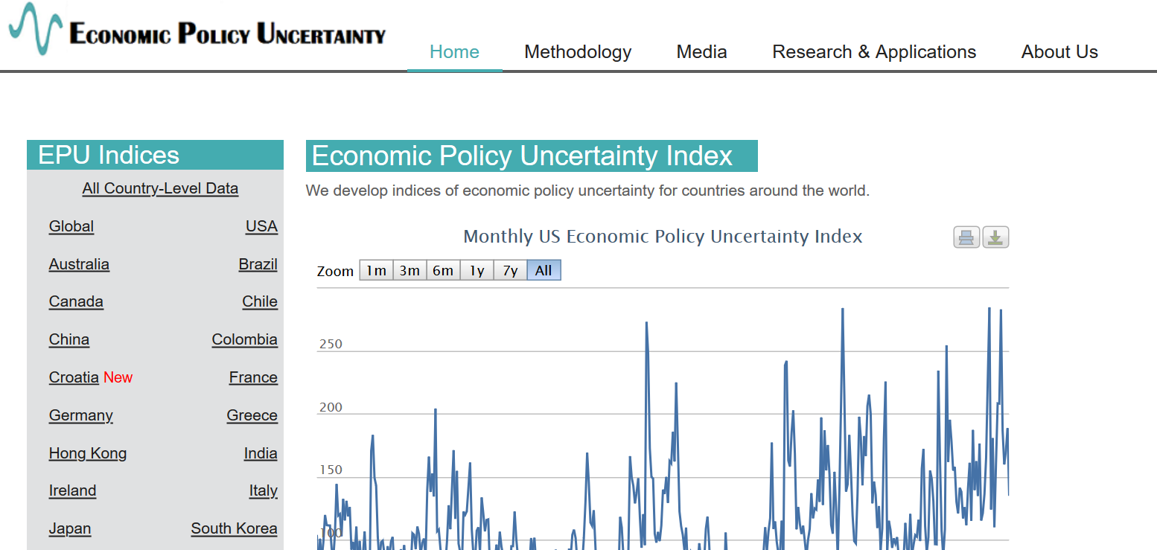
Example 2: Academic data publisher

Slide 98

Example 2: Academic data publisher

Slide 99

Example 2: Academic data publisher-new!

Slide 100
Rights to use data
You browsed a website
You purchased the data
You signed a data use agreement
You created the data (lab experiment)
You had survey respondents consent to use (IRB approval!)

Slide 101
Rights to distribute the data
If you created the data, you decide.
If you got it from somewhere else:
READ THE TERMS OF USE / DATA USE AGREEMENT / CLICK-THROUGH / ETC.

Slide 102
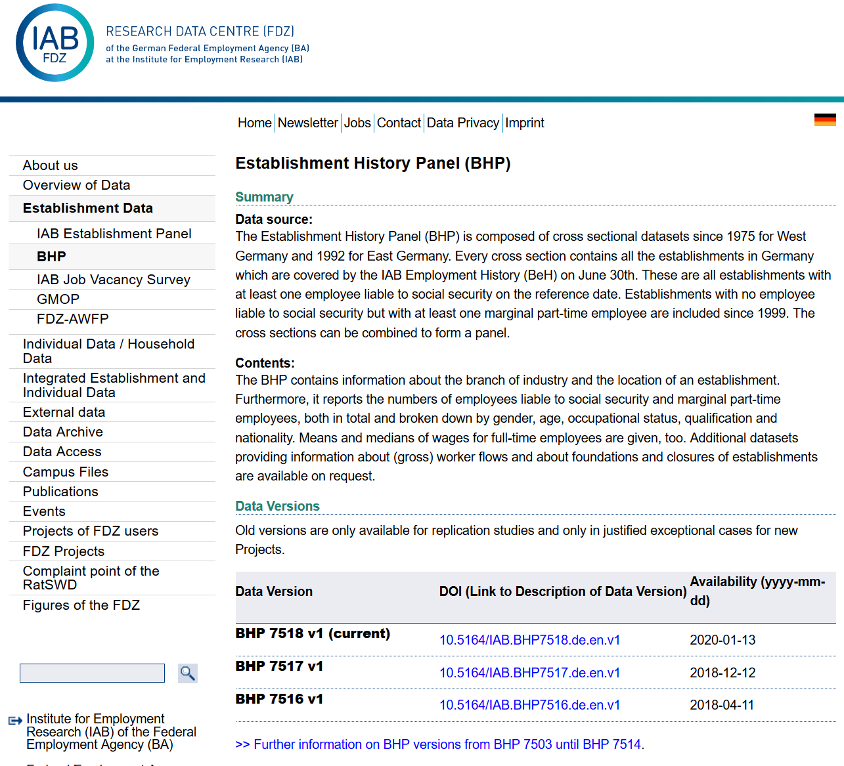
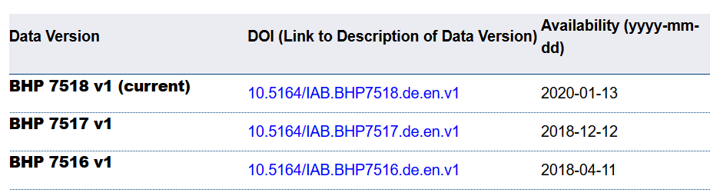
Example 4: German Restricted-access

Slide 103

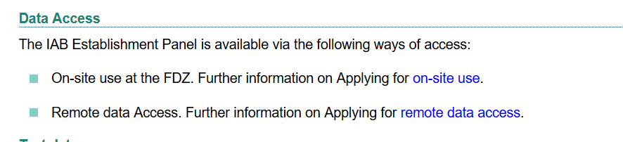
Example 4: German Restricted-access

Slide 104
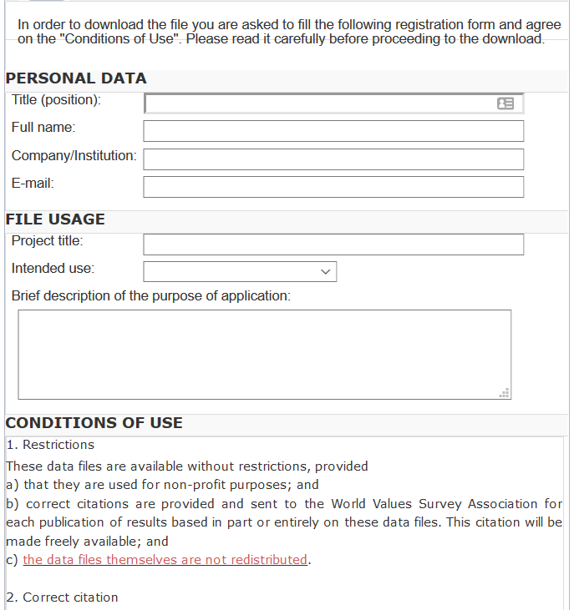
And we check them!
What does the site say?
Please use the following citation when referring to this file in the different versions: Inglehart, R., C. Haerpfer, A. Moreno, C. Welzel, K. Kizilova, J. Diez-Medrano, M. Lagos, P. Norris, E. Ponarin & B. Puranen et al. (eds.). 2014. World Values Survey: Round Six - Country-Pooled Datafile Version: www.worldvaluessurvey.org/WVSDocumentationWV6.jsp. Madrid: JD Systems Institute.
Is that in the README / Paper/ Appendix?
Are all the conditions met/described?

Slide 105
Solution 2: Data Provenance
Keep detailed notes
script as much as possible
(also: Use the Social Science Data Editors’ template README)

Slide 106
Keeping track: Students and Researchers
Computational empathy Consider the next person to run the analysis, and don’t assume too much
Track data (provenance) even when using API, especially when manually downloading, keep in mind what the next downloader may see/find/receive, terms of use

Slide 107
Coding for Reproducibility

Slide 108
Lesson 1: Computational empathy
= “Pity the poor replicator”

Slide 109

Streamlining replication packages
Master script preferred
Least amount of manual effort
No manual manipulation
“Change the parameter to 0.2, then run the code again”
No manual copying of results
Write out/save tables and figures using packages
Compute all numbers in package
No manual install of packages
Use a script to create all directories, install all necessary packages/requirements/etc.
Clear instructions!

Slide 110
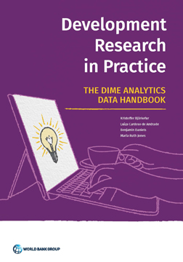
But I don’t need to tell you that
DIME Wiki, Handbook, this course!
https://www.worldbank.org/en/research/dime/data-and-analytics

Slide 111
Observation 5
(Academic) Social scientists do not read the manual… (or at least not some key parts)

Slide 112
Extreme examples
Matlab-based simulation
Real example, 10 figures, 4 panels each
For Figure 5a, comment line 52, uncomment line 151, run the code, then copy the figure into your document.
For Figure 5b, comment line 151 again, leave line 52 commented, and change the parameter on line 75 to “3”
….

Slide 113
Extreme examples
Matlab-based simulation
Real example, 10 figures, 4 panels each
For Figure 5a, comment line 52, uncomment line 151, run the code, then copy the figure into your document.
For Figure 5b, comment line 151 again, leave line 52 commented, and change the parameter on line 75 to “3”
….
Write re-usable code
Use primitive I/O to read parameter files

Slide 114
Extreme examples
Stata-based estimation
4 variants
Run the data creation programs, then copy the data to Folder A
Copy programs “b.do” and “c.do” from Folder A to Folder B, but modify “c.do” on line 20
Once done, convert the output from “d.do” to a Matlab file, and run the simulation in Folder B/C
….

Slide 115
Extreme examples
Stata-based estimation
4 variants
Run the data creation programs, then copy the data to Folder A
Copy programs “b.do” and “c.do” from Folder A to Folder B, but modify “c.do” on line 20
Once done, convert the output from “d.do” to a Matlab file, and run the simulation in Folder B/C
….
Re-use code files (ado)
Use relative or root-relative paths

Slide 116
Ideal setup
1 program to prepare the setup
Installs all packages
Creates all directories
1 program (or a very small number) that creates the rest
Possibly with macros/ ado files/ subroutines
Possibly with parameter files that might differ per directory
All tables and figures are output programmatically
Setting up can be done in all languages
Matlab, Stata, R, Python, Fortran
Subroutines exist in all languages
You might need to learn how!
Ability to output figures and tables (Excel, LaTeX) exist in all languages

Slide 117
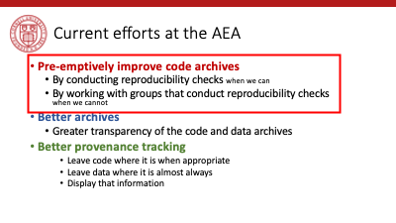
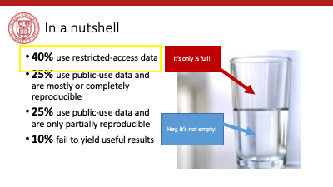
Tension between access and reproducibility

Slide 118


Verification services

Slide 119
Assume replicators can access the data
Sometimes we (=AEA) cannot
We will still check if the code seems complete
We will still verify that all data that *can* be provided have been provided
Plausibility checks
Sometimes we can:
In the past, we have worked with
French, Brazilian, and US confidential admin data
Purchased commercial data (Twitter, Indian GDP)
Proprietary data under NDA/DUA (Ebay)
Data with application procedure (Chinese Panel, Demographic and Health Survey, European establishment data)
Remotely or locally

Slide 120
Solution 3: Learn basics of programming
Code reproducibly
(and do so right from the start)
(also: way easier to describe in the Social Science Data Editors’ template README)

Slide 121
Keeping track: Students and Researchers
Computational empathy Consider the next person to run the analysis, and don’t assume too much
Track data even when using API, especially when manually downloading, keep in mind what the next downloader may see/find/receive, terms of use
Learn the basics of programming code reproducibly, use parameter files, re-usable code, robust file structure

Slide 122
That’s a lot of stuff to learn and remember… I want to focus on the economics!

Slide 123
Keeping track: Students and Researchers
Computational empathy Consider the next person to run the analysis, and don’t assume too much
Track data even when using API, especially when manually downloading, keep in mind what the next downloader may see/find/receive, terms of use
Learn the basics of programming code reproducibly, use parameter files, re-usable code, robust file structure
Learn to automate Run all code again and again, use APIs to download, use conditional processing to handle various aspects
Preserve it all Use version control, tag releases, preserve data (separately), understand the difference between sharing and preserving

Slide 124
That’s a lot of stuff to learn and remember… I want to focus on the economics!

Slide 125
Support by Institutions

Slide 126
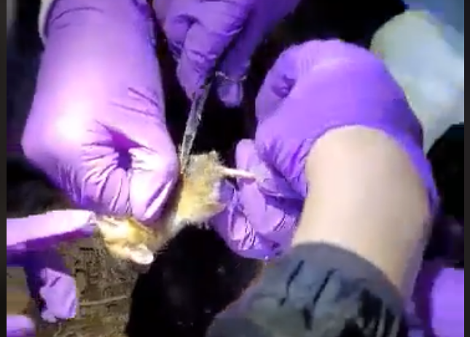
Lesson 3: Support by institutions is insufficient
When should these skills be taught?
These are core “tools of the trade”!
Undergrad, core part of graduate curricula
In other disciplines: students learn how to collect use a pipette, how to tag field mice in the wild…

Slide 127
Lesson 3: Support by institutions is insufficient
Should all of these skills be taught?
How to deposit data
How to set up a compute cluster
Some of these skills fall into other categories, but
Data librarians are understaffed, and not trained in discipline-specific practices
Campus IT has highly varying funding and consulting time
Cross-campus IT practices are nowhere close to compatible

Slide 128
Lesson 3: Support by institutions is insufficient
Institutional funding and mandates are not adequate
Most grant funding in social sciences does not require (or allow!) for this kind of budgeting
Earmarked portions of funds would be great!
(This is slowly coming, NSF and NIH are making progress)
(Most) Universities consider this an external mandate, not part of their “overhead”
“Provide us with an account, and we will do it”
Leads to highly scattershot infrastructure

Slide 129
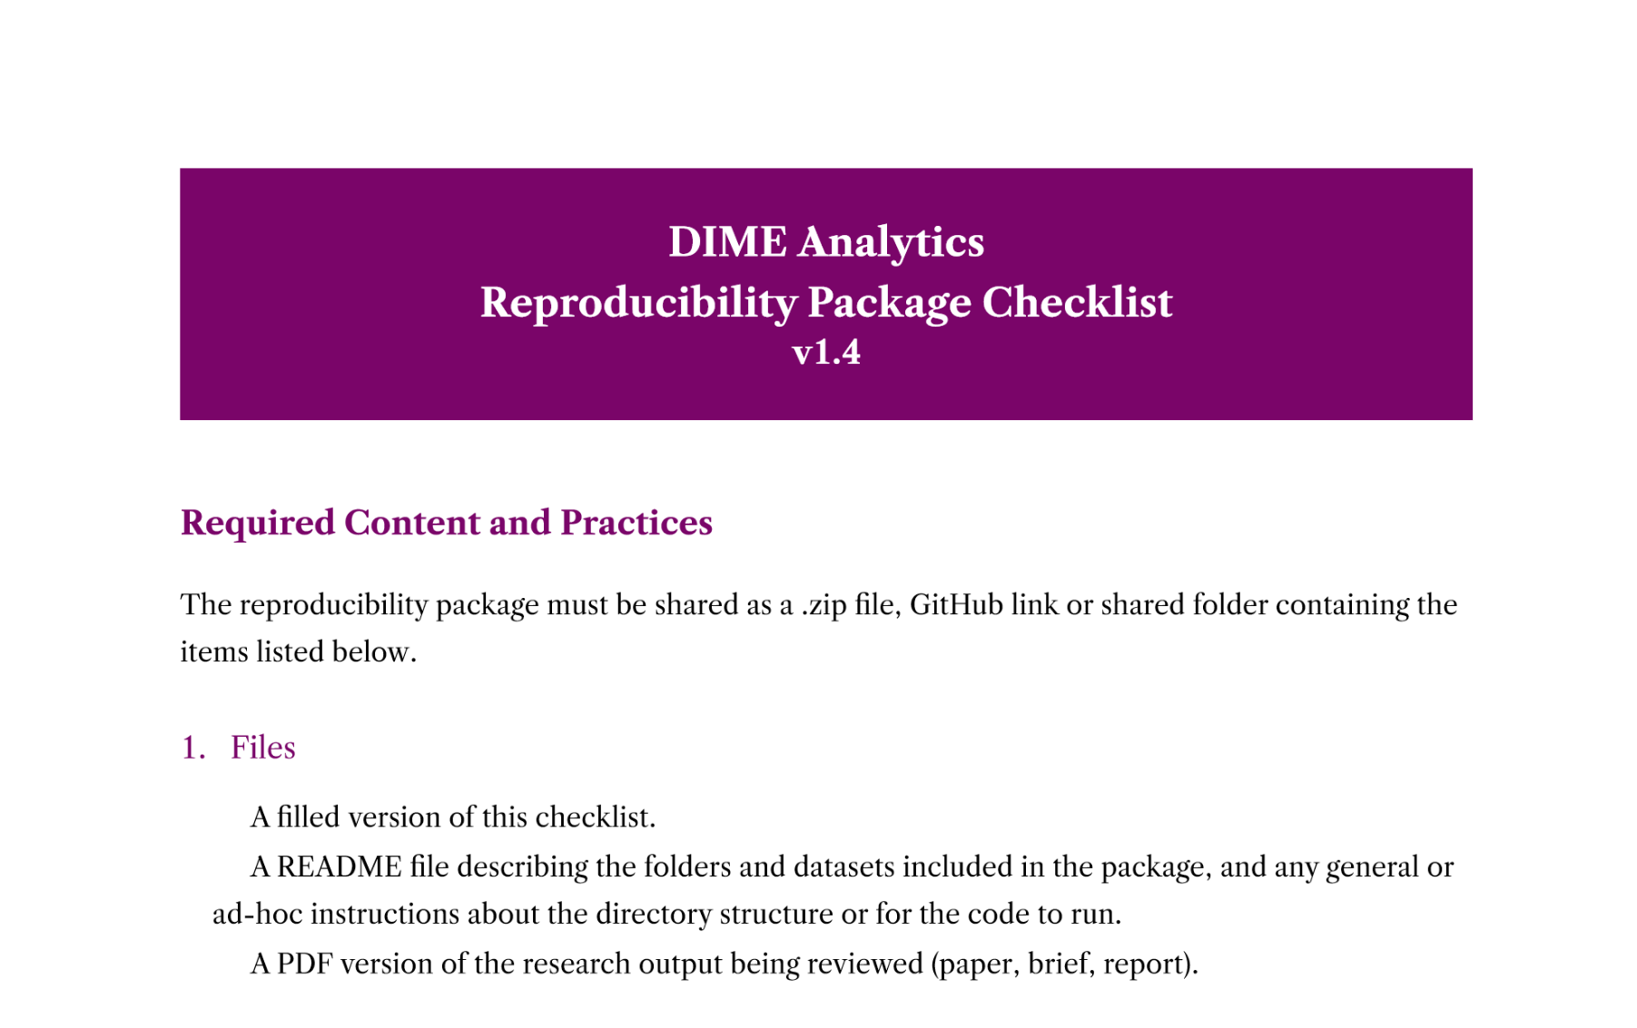
Luckily, you have DIME

Slide 130
Lesson 3: Support by institutions is insufficient
Disciplinary institutions need funding
Direct funding: should archives be treated like infrastructure?
This is the case in many NIH archives
Not quite as ubiquitous in social sciences
Where do you want to preserve 1TB per user per day for the next 50 years? It’s not free…
Indirect funding (via grants)
See previous slide

Slide 131
Lesson 3: Support by institutions is insufficient
All institutions need to consider the user experience
Data provenance and preservation would be a lot easier to implement if scripted
Need for APIs both for upload and download (usage)
Some progress: Zenodo and Dataverse (usually Python, sometimes R)

Slide 132
Lesson 3: Support by institutions is insufficient
Integration of computational resources with data resources is highly inadequate
Most journals have “data” policies, but all research compendia have code – this is a problem with many publishers
Most data repositories are optimized for … data. Support for computational code or actual execution is at best preliminary
See CodeOcean, WholeTale, efforts around Dataverse
See various “continuous integration” using Github, Travis CI, etc. but difficult to integrate data

Slide 133
Solution 6: Institutional support
(departments, schools, libraries, IT, universities)
Offer training in adapted tools (not sufficient to just show how to do a Rmarkdown document)
Highlight appropriate community (Zenodo, Dataverse, others) or university sites
Provide streamlined access to some frequently used (open/commercial) tools (AWS/GCS/Azure, CI on Github/others, etc.)

Slide 134
Some thoughts for the role of Faculty
Encourage students to learn new skills outside of economics Even or especially if you do not have the time to do so
Demand reproducibility when reviewing (articles, theses, intermediate reports from students, etc.) automated re-runs on Github, which particular release to review, refusing emailed copies
Incentivize reproducibility For robustness, for efficiency, but also training for exposure to the discipline. Example: Replication Challenges

Slide 135

Please don’t produce irreproducible articles!

Slide 136
The role for journals

Slide 137
Goal: Transportability
Any standards, tools, methods: must be transportable across journals (no custom solutions)

Slide 138

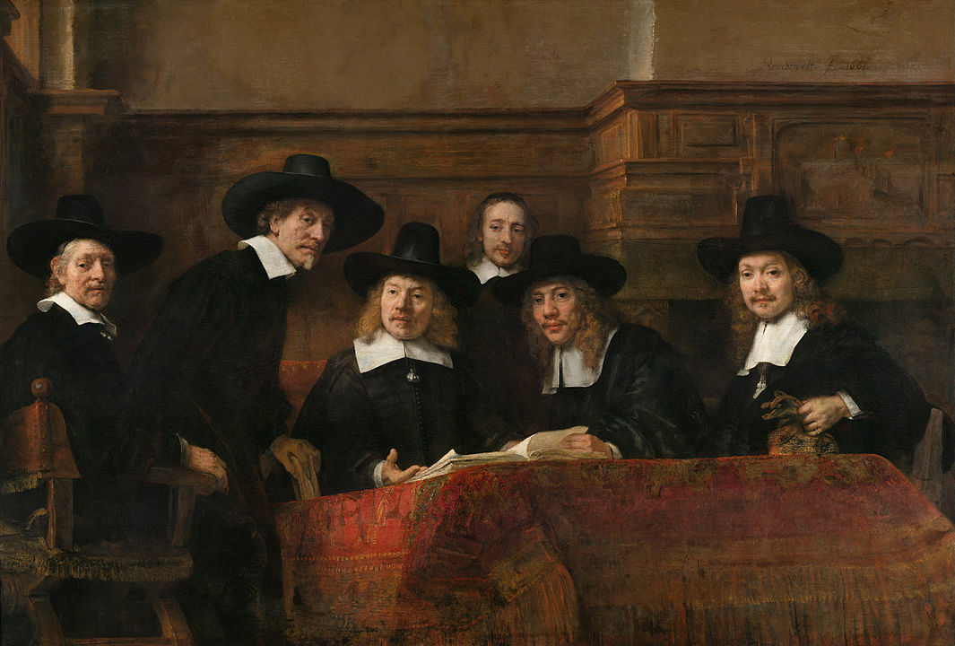
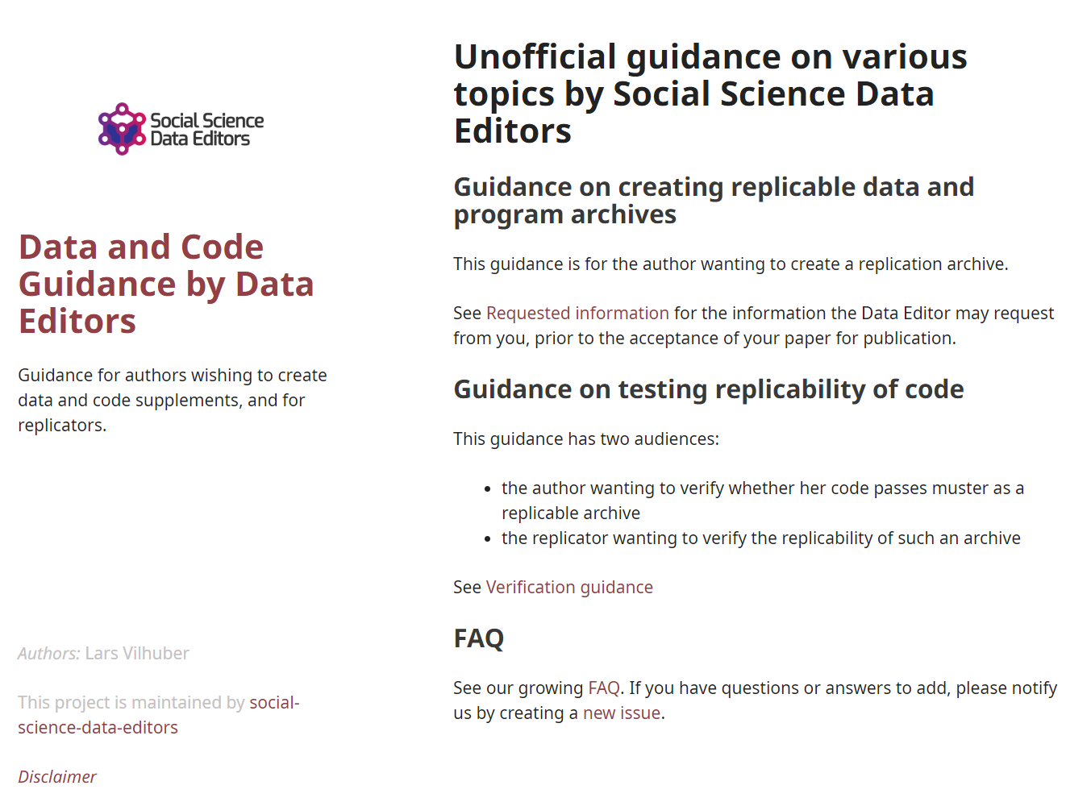
Social science “guild”
https:// social-science -data-editors. github.io/ guidance/

Slide 139
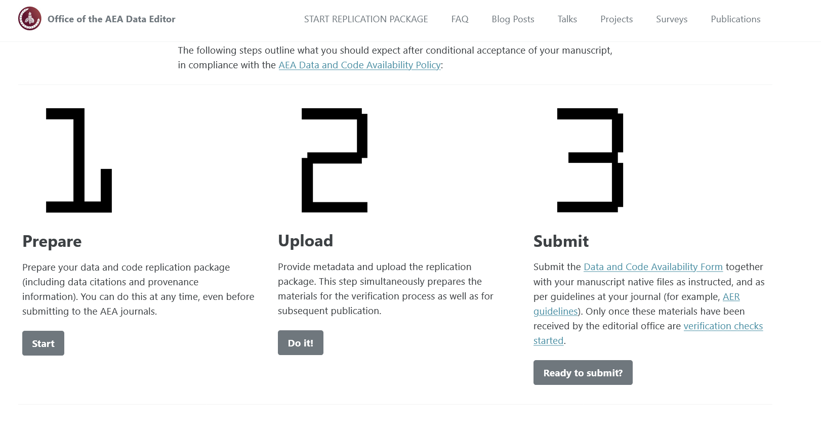

Some resources
https://social-science-data-editors.github.io/guidance/
template README
discussion of licensing
data citation guidance
https://aeadataeditor.github.io/

Slide 140
Thank you!

Slide 141
Reminder: Students and Researchers
Computational empathy Consider the next person to run the analysis, and don’t assume too much
Track data even when using API, especially when manually downloading, keep in mind what the next downloader may see/find/receive, terms of use
Learn the basics of programming code reproducibly, use parameter files, re-usable code, robust file structure
Learn to automate Run all code again and again, use APIs to download, use conditional processing to handle various aspects
Preserve it all Use version control, tag releases, preserve data (separately), understand the difference between sharing and preserving

Slide 143
Data Citations

Slide 144
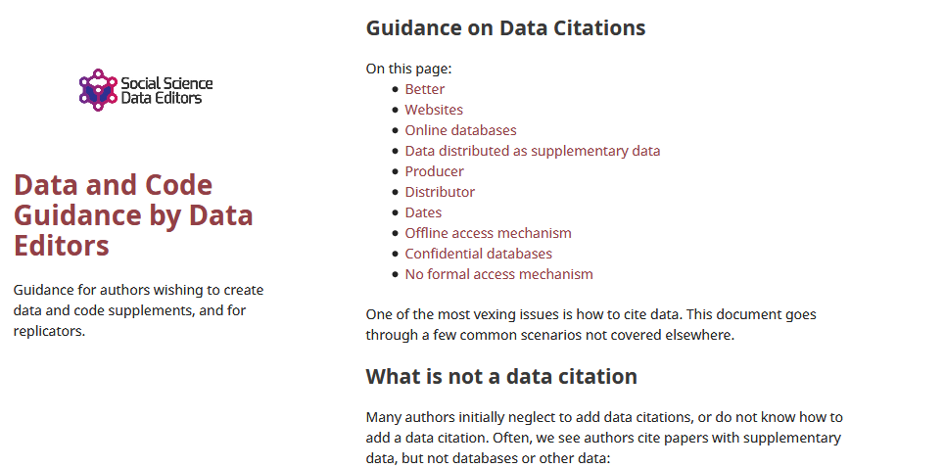
Data citations
Creating specific guidance in the absence of strong discipline-specific guidance
https://social-science-data-editors.github.io/guidance/addtl-data-citation-guidance.html

Slide 145
Example 4: German Restricted-access

Slide 146
Data Citation
Attributes the file to the proper source

Slide 147
Element of a (data) citation
ICPSR notes that a citation should include the following items:
Author
Title
Distributor
Date
Version
Persistent identifier
Suggested Citation:
S&P Dow Jones Indices LLC, S&P 500 [SP500], retrieved from FRED, Federal Reserve Bank of St. Louis; https://fred.stlouisfed.org/series/SP500, June 26, 2020.

Slide 148
Element of a (data) citation
ICPSR notes that a citation should include the following items:
Author
Title
Distributor
Date
Version
Persistent identifier
Constructed Citation:
Institute for Employment Research (IAB), Establishment History Panel 1975-2018. Accessed via the Research Data Centre (FDZ) of the German Federal Employment Agency DOI: 10.5164/IAB.BHP7518.de.en.v1 June 26, 2020.

Slide 149
Element of a (data) citation
ICPSR notes that a citation should include the following items:
Author
Title
Distributor
Date
Version
Persistent identifier
Constructed Citation:
US Census Bureau, Longitudinal Business Database (LBD) 1975-2018. Last accessed via the Federal Statistical Research Data Centre (FSRDC) June 26, 2020.

Slide 150
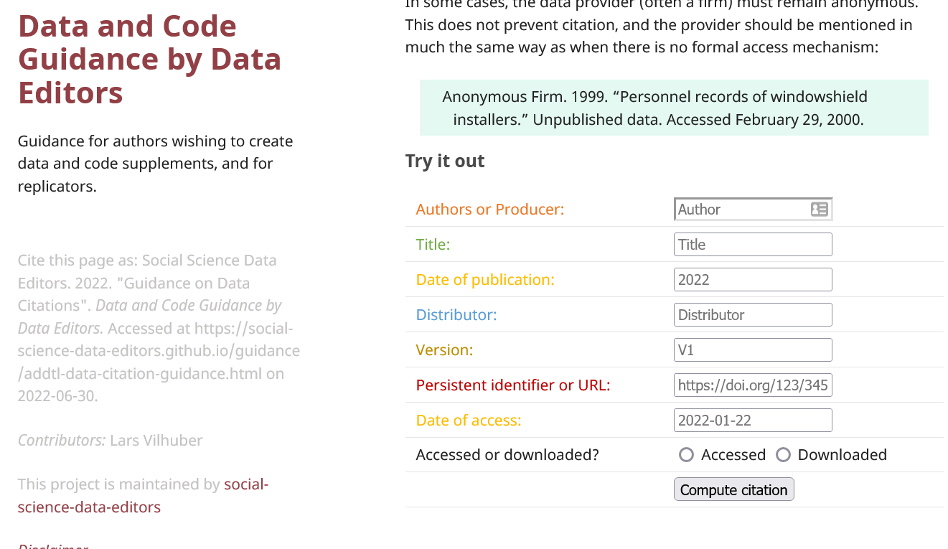
Try it out yourself
Construct an (approximate) data citation
https://social-science-data-editors.github.io/guidance/addtl-data-citation-guidance.html#try-it-out

Slide 151
Data: Citations, Access, Rights
Any data can be cited – even if you can’t download it
Any data that you accessed … can have that access be described
But caution: It should be such that others can also repeat the access!
Just because you “have” the data does not mean you can give it to others
Also: distinguish between “sharing” and “publishing”
Know your terms of use!

Slide 152
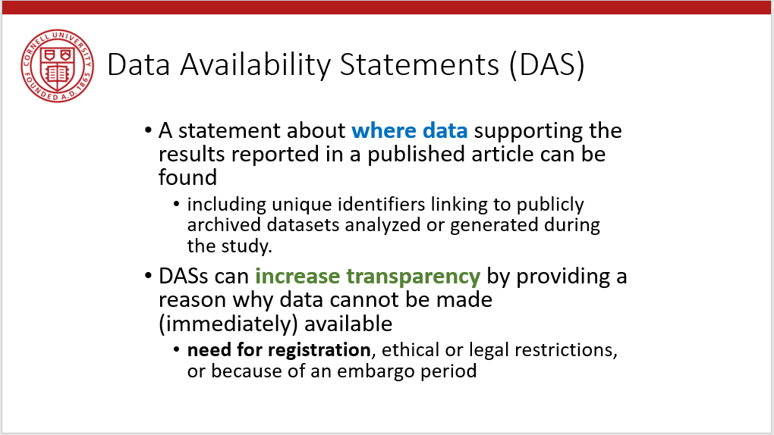

Provide data citations (in manuscript) and data availability statements (in README or appendix)

Slide 153
Solution 3: Data Citations
Cite every data source
(not only the paper that describes the source!)
(also: add them to the Social Science Data Editors’ template README)

